Slide 1




NEVADA STATE CONTRACTORS BOARD
LICENSED CONTRACTOR ASSISTANCE PROGRAM
An online workshop to guide you through making changes to your Nevada contractor’s license.
What you’ll get from this program…
Understanding the proper steps to take when changes to the license occur
Information on how to raise the license monetary limit, broaden a license classification, change/add an officer or change a qualified individual on a license
Required application fees
Information on important Nevada laws that impact licensing
1
Notes:
Welcome to the Licensed Contractor Assistance Program, presented by the Nevada State Contractors Board.
This online workshop is designed to guide you through making changes to your Nevada contractor’s license.
We’ll cover the proper steps to take when updates occur, including raising your monetary limit, modifying your license classification, or updating personnel on your license.
We’ll also go over application fees and important Nevada laws that impact your license.

Slide 2


ACCESSING MATERIALS
You can download today’s presentation, along with the application/request forms, by visiting the Board’s website:
www.nscb.nv.gov
PARTICIPANT EXPECTATIONS
Participants’ video and audio features will be disabled by the Board until the conclusion of the presentation.
Questions will be taken at the end of the presentation, at which time your audio will be turned on.
Participants are welcome to use the CHAT feature during the presentation to submit questions.
Disruptive or offensive behavior during the presentation will result in a warning and could result in permanent removal from the meeting.
2
Notes:
During this program, you’ll learn how to access important materials, including downloadable forms and applications available on the Board’s website.
Please note that participant audio and video will remain disabled during the presentation.
Questions will be answered at the end, and you can also submit questions using the chat feature throughout.
We ask that all participants remain respectful—disruptive behavior may result in removal.

Slide 3
PLEASE NOTE ...
The information obtained during this webcast is not, nor intended to be, legal advice.
While this webcast contains general information, including legal guidelines for contractor applications, it does not contain definitive statements of the law and may not reflect the most current legal developments in the construction industry.
Such guidelines communicated or discussed during the webcast are strictly for informational purposes only.
If you have questions about the application of law for specific situations, we recommend you contact an attorney who is familiar with Nevada law, or review the statutory and regulatory requirements under NRS Chapter 624 and NAC Chapter 624.
3
Notes:
Before we begin, please note that this presentation provides general information and legal guidelines, but it is not legal advice.
Laws and regulations may change, so for specific situations, you should consult an attorney or review Nevada Revised Statutes Chapter 624 and Nevada Administrative Code Chapter 624.

Slide 4

THANK YOU!
THANK YOU for being a licensed contractor in Nevada!
Having a contractor’s license is a great responsibility and we appreciate your desire to ensure you’re complying with Nevada law.
The Nevada State Contractors Board is not affiliated with and cannot recommend application assistance from any other group or company. Information provided by third-party services cannot be relied upon to be accurate.
Please contact staff at the Nevada State Contractors Board with questions about your license!
4
Notes:
Thank you for taking the time to ensure you are complying with Nevada law.
Holding a contractor’s license is a significant responsibility, and we appreciate your commitment.
Please remember, the Nevada State Contractors Board does not recommend third-party application assistance services. Information provided by a third party service cannot be relied upon to be accurate. Please contact our staff for any questions regarding your license

Slide 5

CONTACTING THE BOARD
By Email:
customerservice@nscb.state.nv.us
By Phone, Mail or Personal Delivery:
SOUTHERN NEVADA
8400 West Sunset Road, Suite 150
Las Vegas, Nevada 89113
(702) 486-1100
NORTHERN NEVADA
5390 Kietzke Lane, Suite 102
Reno, Nevada 89511
(775) 688-1141
5
Notes:
If you need assistance, you can contact the Board by email, phone, mail, or in person at the Southern Nevada office in Las Vegas or Northern Nevada office in Reno.

Slide 6

NSCB Website
FORMS &
LOCATION
www.nscb.nv.gov
Quick Link
Forms and Applications
New Contractor License Application
Contractors License Application (.pdf)
Contractors License Application (online forms)
Contractor License Change Forms
Activate an Inactive License
Broadening of Classification
Change or Add a Corporate Officer or Member/Manager
Change or Add a Qualified Individual
Conversion of Entity
Disassociation of a Qualified Individual
Inactivate an Active License
Name Change Application
Permanent Raise in Limit
Single Project Limit Increase
Voluntary Surrender Request Form
6
Notes:
All forms and applications can be found on the Nevada State Contractors Board website under “Forms and Applications.” This tab will include our various change forms accessible on our website.

Slide 7

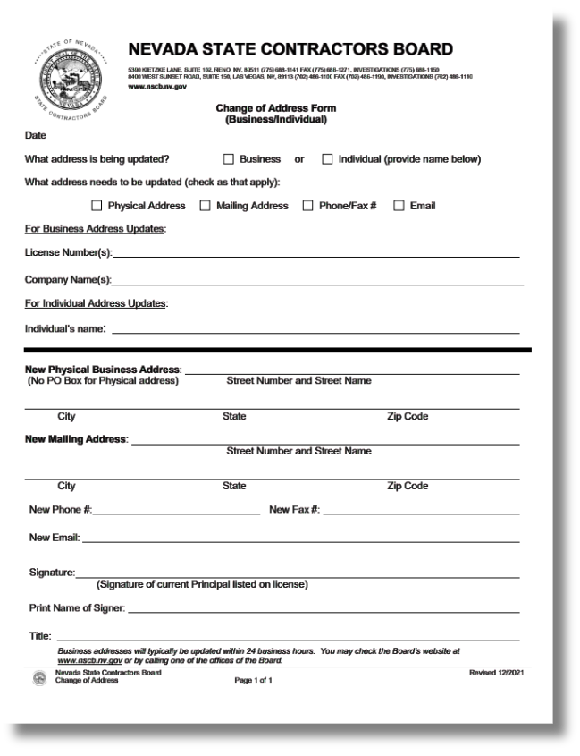

NOTIFYING THE NSCB
OF CHANGES
Change of Address
Application: Change of Address Form
  This form is used to change:
- personal and/or business address;
- phone number; or
- email address.
  No fee
  Request must be signed by a current principal listed on the license
  Can be submitted by email, US Mail or in person
  You can also update address information using the Online Dashboard (typically updated within 24-business hours)
  Address changes MUST be updated IN WRITING within 30 DAYS of the change.
7
PLEASE BE ADVISED
ALL PRINCIPALS, CMS QUALIFIERS AND TRADE QUALIFIERS ARE RESPONSIBLE FOR ANY COMPLAINTS RECEIVED ON A LICENSE!
Notes:
If your contact information changes, you must notify the Board in writing within 30 days. Our change of address form is used to modify your personal and or business address, phone number, and email address. There is no fee attached to this application. The form must be signed by a principal on the license for the changes to take effect. You may submit this form through mail, email, or in person.

Slide 8
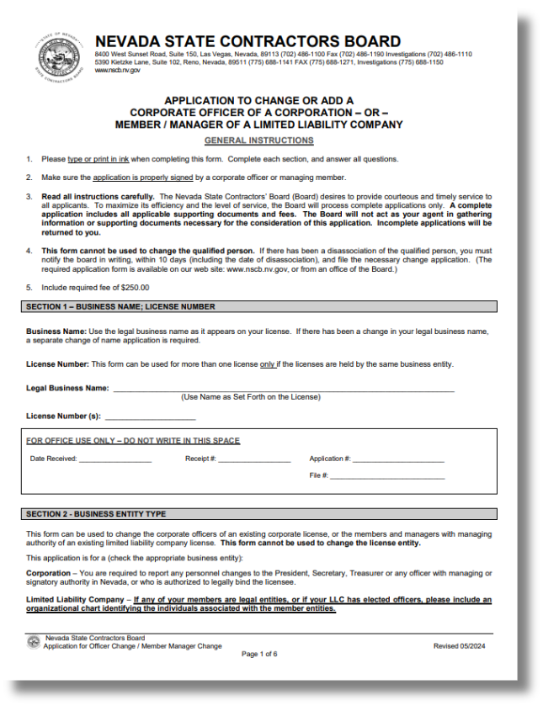
NOTIFYING THE NSCB
OF CHANGES
Changes in Principals
Application: Change or Add a Corporate Officer or Member/Manager
  This form is used to change:
- Corporate Officers of an existing corporate license;
- Members and Managers (with managing authority) of an existing LLC
license; or
- Partners of a Limited Partnership.
  $250 fee
  This form is required if you are ADDING or REMOVING principals from a license
  This form cannot be used to change the Qualified Individual or change the license entity.
  Principal changes MUST be updated IN WRITING within 30 DAYS of the change.
8
PLEASE BE ADVISED
ALL PRINCIPALS, CMS QUALIFIERS AND TRADE QUALIFIERS ARE RESPONSIBLE FOR ANY COMPLAINTS RECEIVED ON A LICENSE!
Notes:
To add or remove principals, submit the Changer or add a corporate officer form with a $250 fee within 30 days. This form is required if you are adding or removing principals from a license, corporate officers on an existing corporate license, members and managers of an existing LLC or partners in a limited partnership. This form is not used to change or add qualified individuals on a license entity. Please be advised

Slide 9
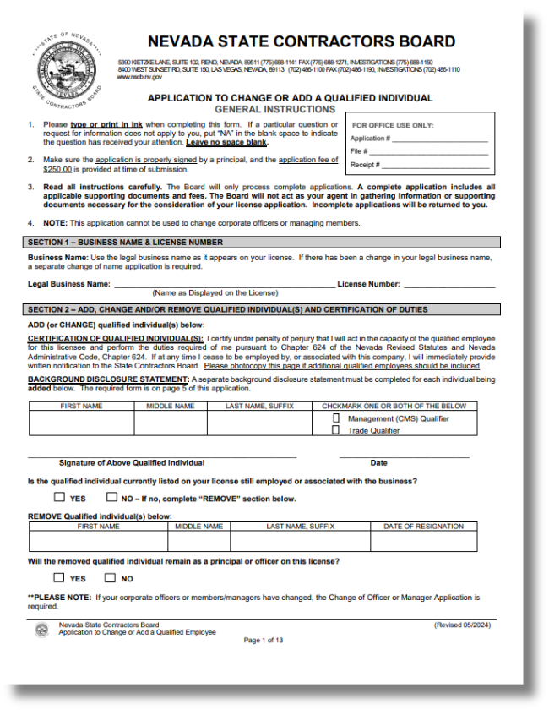
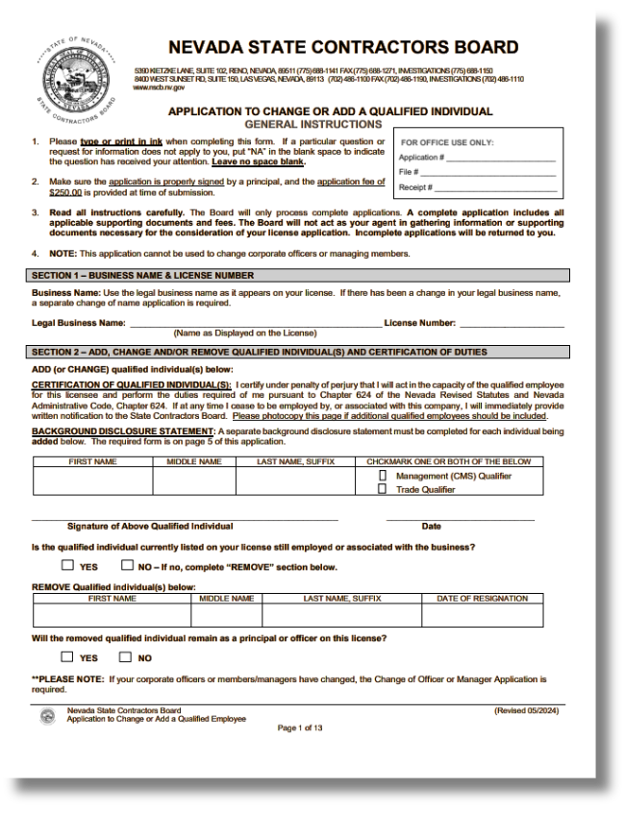
NOTIFYING THE NSCB
OF CHANGES
Changes in Qualified Individual(s)
Application: Change or Add a Qualified Individual
  This form is used to:
- ADD or CHANGE the Qualified Individual(s) on a license
  This form cannot be used to change the Principal(s) of a license or change the license entity.
  $250 fee
9
PLEASE BE ADVISED
ALL PRINCIPALS, CMS QUALIFIERS AND TRADE QUALIFIERS ARE RESPONSIBLE FOR ANY COMPLAINTS RECEIVED ON A LICENSE!
Notes:
To add or change a qualified individual, the Change of Qualifier application must be submitted with a $250 fee

Slide 10
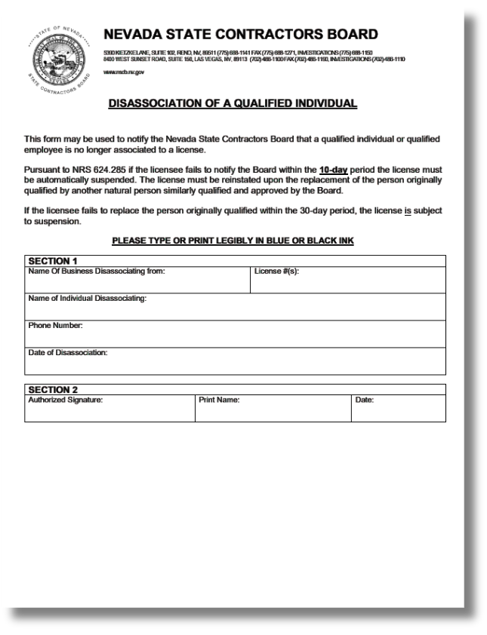
NOTIFYING THE NSCB
OF CHANGES
Qualifier Disassociation
Application: Disassociation of a Qualified Individual
  This form is used for:
- disassociation or resignation of a Qualified Individual
  The qualifier change form is NOT required if you are only REMOVING a Qualified Individual.
  Required to notify the Board IN WRITING within 10 DAYS of a Qualified Individual’s resignation or disassociation
  No fee
10
PLEASE BE ADVISED
ALL PRINCIPALS, CMS QUALIFIERS AND TRADE QUALIFIERS ARE RESPONSIBLE FOR ANY COMPLAINTS RECEIVED ON A LICENSE!
Notes:
If a qualified individual leaves, the Board requires a notice within 10 days. The Disassociation of Qualified Individual is used for the resignation or dissociation of a qualified individual. The Change of Qualifier application is not required if you are only removing a Qualified Individual. There is no fee required for this application.

Slide 11
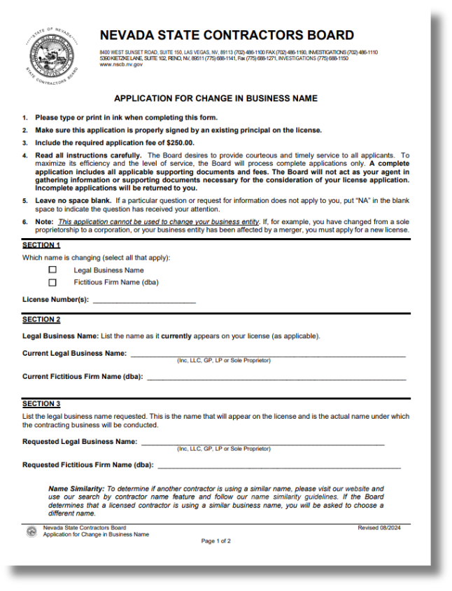
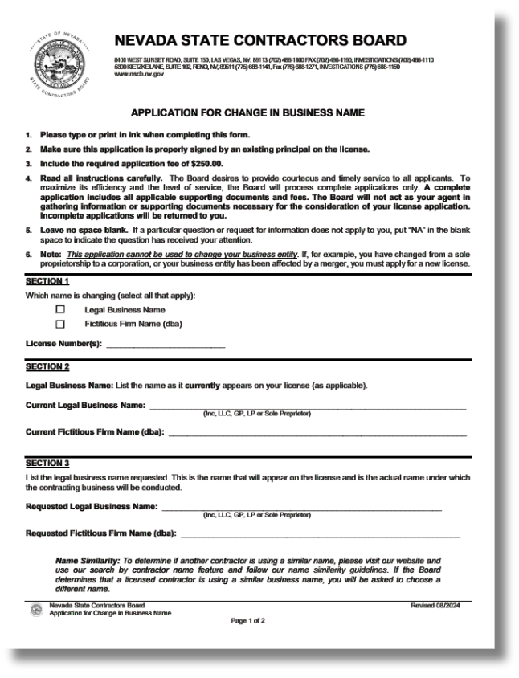
NOTIFYING THE NSCB
OF CHANGES
Legal Business Name Change
Application: Name Change Application
  This form is required if:
- the entity name has been modified with the Secretary of State; or
- adding or removing a fictitious firm name / dba (“doing business as”)
  $250 fee
11
PLEASE BE ADVISED
ALL PRINCIPALS, CMS QUALIFIERS AND TRADE QUALIFIERS ARE RESPONSIBLE FOR ANY COMPLAINTS RECEIVED ON A LICENSE!
Notes:
You may submit a Name Change Application with a $250 fee if your legal business name has been changed with the Secretary of State or if you will be adding or removing a fictitious firm name, known as a DBA

Slide 12
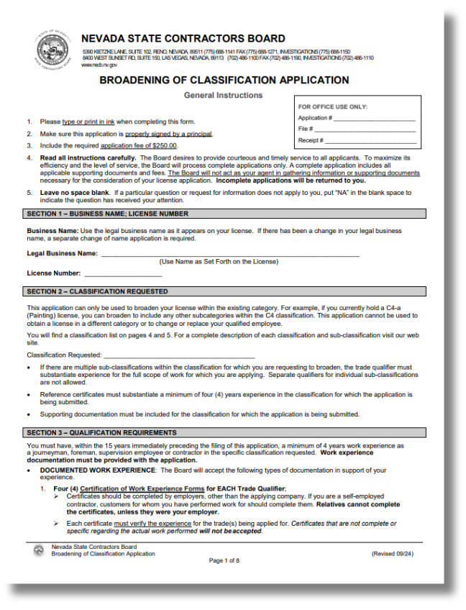

BROADENING
Broadening of Classification
Application: Broadening of Classification
  Adds subclassifications to existing licenses
  CANNOT be used to add a separate primary classification
  $250 fee
12

Slide 13
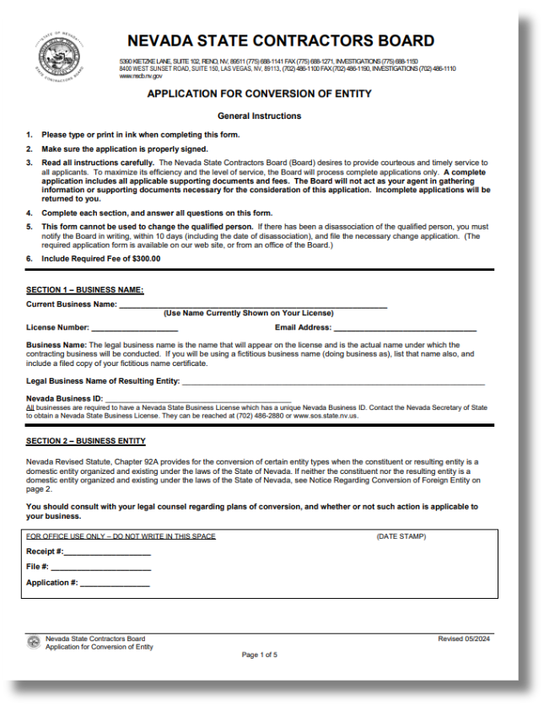
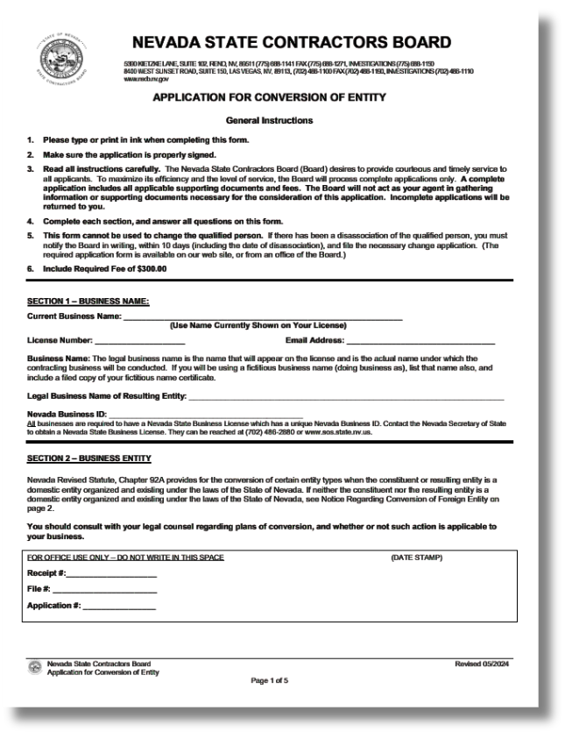
CONVERSION
Conversion of Entity
Application: Conversion of Entity
  $300 fee
  NAC 624.667 Submission of application regarding conversion of business organization of licensee. (NRS 624.100) A licensee shall submit an application to the Board regarding a conversion of the licensee conducted pursuant to chapter 92A of NRS before or within 30 days after such a conversion is made.
13
Notes:
A conversion of entity consists of the conversion of an entity’s filing with the Nevada Secretary of State. PURSUANT TO CHAPTER 92A of NRS, this application must be submitted before or within 30 days after such conversion is made. The change is primarily used in scenarios a filing is switched from an LLC to a corporation or a corporation to an LLC. Sole proprietorships may not utilize this application to change their entity filing to an LLC or corporation, instead they must submit a new contractors license application.

Slide 14

MONETARY LIMIT
Every contractor license has a MONETARY LIMIT.
The monetary limit is the MAXIMUM value a contractor may charge their client per contract.
You may NOT bid or contract for any amount that exceeds your monetary limit or the contract will be void. (NRS 624.640)
Upon approval for a raise in limit, a bond amount adjustment may be required.
If you have questions about NRS 624.640 regarding monetary limits on a license, you are welcome to call our customer service line and request to speak with a compliance officer.
NEED TO MAKE CHANGES?
14
Notes:
The monetary limit is the maximum value a contractor may charge their client per contract. You may not bid a project that exceeds your monetary limit per NRS 624.640. The raise in limit application may be used to raise your monetary limit, with this, a bond adjust may be required for the higher limit to take effect.

Slide 15
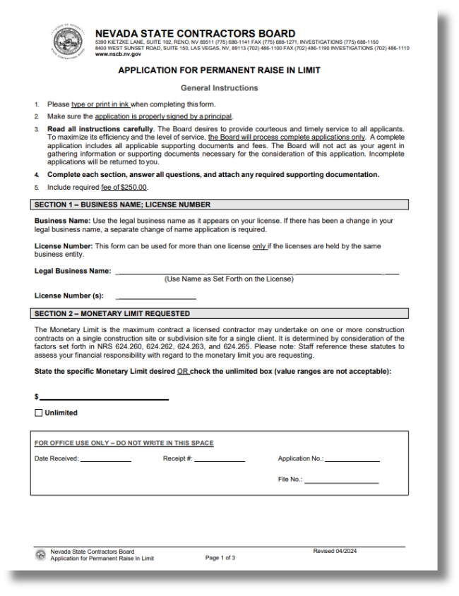
MONETARY LIMIT
Permanent Raise in Limit
Application: Permanent Raise in Limit
  $250 fee
NOTE:
  a financial statement WILL be required for each application
  the financial statement required is based on the limit requested
  Indemnification CAN be used
  a Bank Verification Form is no longer required
15
Notes:
Once again, our permanent raise in limit application will allow you increase your monetary limit.

Slide 16
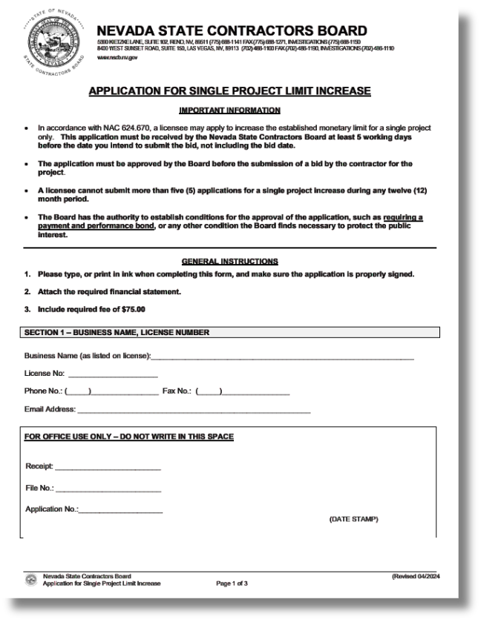
MONETARY LIMIT
Single Project Limit Increase
Application: Single Project Limit Increase
  $75 fee
  Limited to five (5) per calendar year
NOTE:
  a financial statement WILL be required for each application
  the financial statement required is based on the limit requested
  Indemnification CAN be used
  a Bank Verification Form is no longer required
16
Notes:
A single project is a one time limit increase designated for a project. The application fee is $75 and the submittal for this application is limited to 5 one time increases per calendar year.

Slide 17


MONETARY LIMIT
Lower Limit Request
  No application; however ...
  MUST submit a WRITTEN and SIGNED request
  $250 fee
NOTE:
  a financial statement WILL be required for each application
  the financial statement required is based on the limit requested
  Indemnification CAN be used
  a Bank Verification Form is no longer required
17
Notes:
If you are looking to reduce your classification, there is no application form available for this request. However, you must submit a written and signed request with a $250 fee for this adjustment to take place.

Slide 18

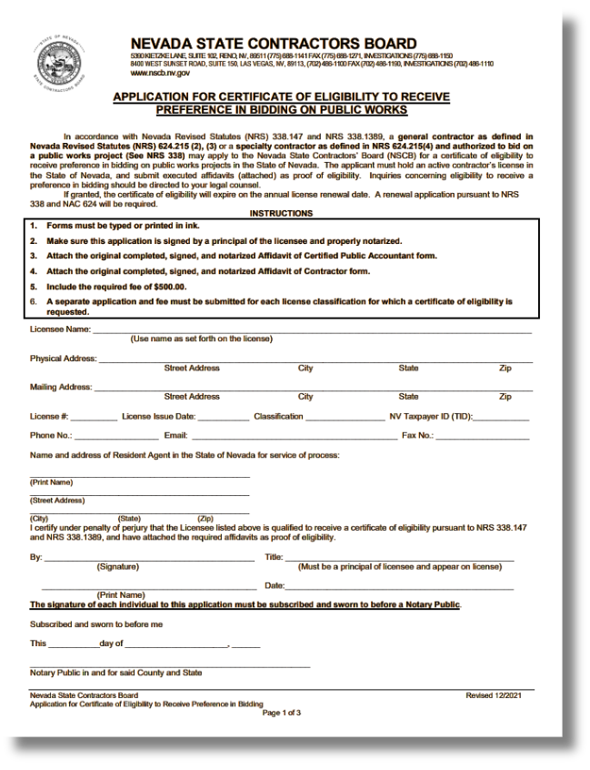

CERTIFICATE OF ELIGIBILITY
RECEIVE
TO
PREFERENCE
BIDDING
PUBLIC WORKS
IN
ON
Certificate of Eligibility to Receive Preference in Bidding on Public Works
Application: Certificate of Eligibility to Receive Preference in Bidding on
Public Works (New Certificates)
  $500 fee
  $300 renewal fee
  Valid for one (1) year
IMPORTANT - Pursuant to NRS 338.147 and NRS 338.1389:
  Available AFTER:
- five (5) years of ACTIVE licensure; and
- five (5) years of paying NEVADA Sales & Use Tax and/or Governmental
Service Tax; or
- obtainment of a viable, operating construction firm (see application for
details)
  Requires CPA affidavit
18
Notes:
A certificate of eligibility to receive preference in bidding on public work requires a $500 application fee with a renewal fee of $300. once approved, the certificate of eligibility is valid for one year.

Slide 19
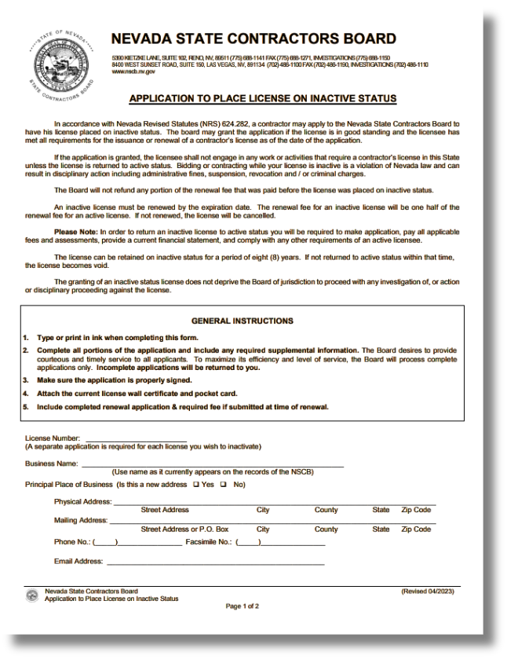
INACTIVATE
A LICENSE
INACTIVATE an ACTIVE License
Application: Inactivate an Active License
  No application fee; however, 50% of active renewal fee due at the time of renewal
  Valid for up to eight (8) years
  Residential Recovery Fund contribution not required while inactive
  Retain ACTIVE status with the Nevada Secretary of State
  Bond not required
  Workers’ Compensation insurance not required
  Cannot enter into contracts or perform construction while on inactive status
19
Notes:
To inactivate a license, you may submit the form with no application fee, however, 50% of the active renewal fee is due at the time of renewal. A license may remain inactive for up to 8 years with no contribution to the residential recovery fund. You must retain an active status with the Nevada Secretary of State. A bond and workers compensation will not be required. You may not enter into contracts or perform construction while on inactive status.

Slide 20
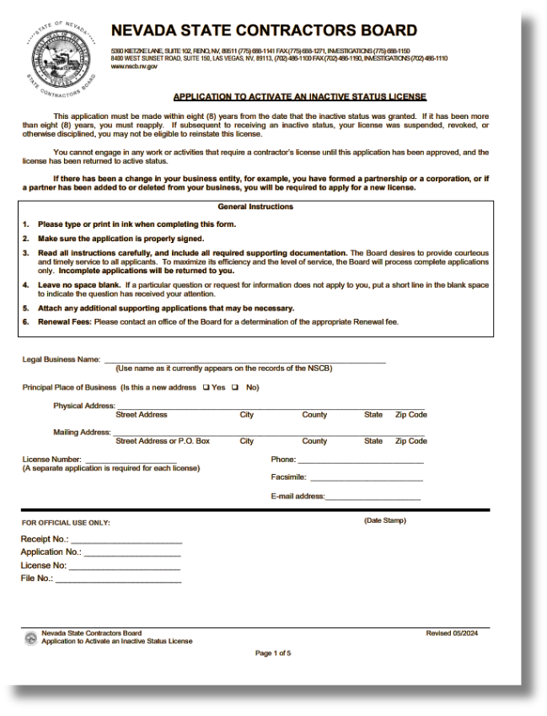
REACTIVATE
A LICENSE
ACTIVATE an INACTIVE License
Application: Activate an Inactive License
  Application fee will be determined by renewal date
  Current financial statement required based on the monetary limit of the license
  Residential Recovery Fund contribution required
  ACTIVE status with the Nevada Secretary of State required
  Bond required
  Workers’ Compensation insurance evidence required
20
Notes:
To reactivate a license, a application fee will be determined by the renewal date. With the application, current and updated financial statements based on the monetary limit are required. The contribution to the Residential Recovery fund and an active status with the Nevada Secretary of State are required. You must acquire a bond and workers compensation insurance.

Slide 21
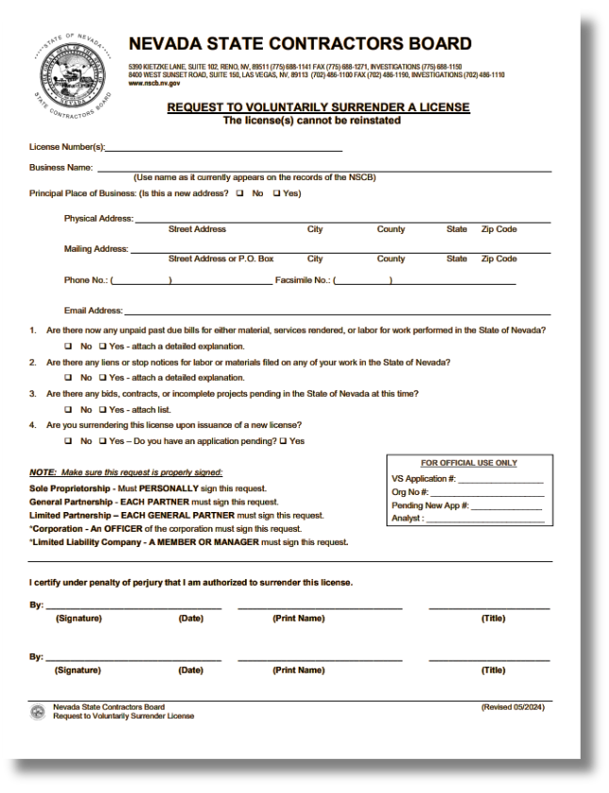
VOLUNTARY SURRENDER /
LICENSE CANCELLATION
Voluntary Surrender
Application: Voluntary Surrender Request Form
  No application fee
  Must be signed by a current principal on the license or a current officer with the Nevada Secretary of State
License Cancellation
  If a license is NOT renewed, it will cancel six (6) months after the date of expiration.
  Once a license cancels, the license will no longer be eligible for renewal.
  A NEW Contractors License Application will be required if you want to contract in the future.
21
Notes:
Our voluntary surrender form may be submitted if you choose to cease operations under your Nevada contractor license. There is no application fee but the form must be signed by a current principal on the license or a current officer on the Nevada Secretary of State.

Slide 22
FINANCIAL REQUIREMENTS
MONETARY LIMITS OF 25,000 OR LESS:
  A current financial statement prepared by an independent Certified Public Accountant; or
  A current financial statement submitted on a Board-approved form (available at our office or on our website); or
  A current financial statement (Balance Sheet) prepared using accounting software in accordance with generally accepted accounting principles.
MONETARY LIMITS OF $25,001 OR MORE, BUT LESS THAN $500,000:
  A compiled financial statement prepared by an independent Certified Public Accountant current within six (6) months from the date the application is received; or
  A financial statement reviewed or audited by an independent Certified Public Accountant current within one (1) year from the date the application is received.
MONETARY LIMITS OF $500,001 OR MORE, BUT LESS THAN $1,000,000:
  A compiled financial statement, with full disclosures, prepared by an independent Certified Public Accountant current within six (6) months from the date the application is received; or
  A financial statement reviewed or audited by an independent Certified Public Accountant current within one (1) year from the date the application is received.
MONETARY LIMITS OF $1,000,001 OR MORE:
  A financial statement that is prepared and reviewed or audited by an independent Certified Public Accountant current within one (1) year from the date the application is received.
22
Notes:
Applicants must submit all business financial statement in U.S. dollars. The type of financial statement required will depend on the monetary limit requested for the license. For example, if you’re aiming for a limit of $10,000 you may submit a self prepared financial statement using our board-approved form on our website or an accounting software in accordance with generally accepted accounting principles. All CPA compiled statements must be current within 6 months from the date the applications is received while reviewed or audited financial statements prepared by an independent CPA are current within one year from the date the application is received.

Slide 23

BOND REQUIREMENTS
Bond Requirements
Bond requirements are established by the Board based on:
  Type of License
  Monetary Limit
  Financial Responsibility
  Experience
Types of Bonds
  Surety Bond
  Cash Bond Deposit (*biennial service fee of $200 upon license renewal)
  Residential Improvement Bond (*per Assembly Bill 39, effective October 1, 2023)(more info next slide)
Bond Amounts
  Bonds may range in value from $1,000 to a maximum of $500,000
  The bond amount may require adjustment after a raise in limit
23
PLEASE NOTE:
Failure to maintain the bond after the license is issued WILL result in suspension of that license.
Notes:
Bond limits are determined by the type of license, monetary limit, and financial responsibility The surety bond is the general requirement for contractors in Nevada. You may have the option of a cash bond with service fee of $200 upon license renewal as well as a residential improvement bond per assembly bill 39.

Slide 24
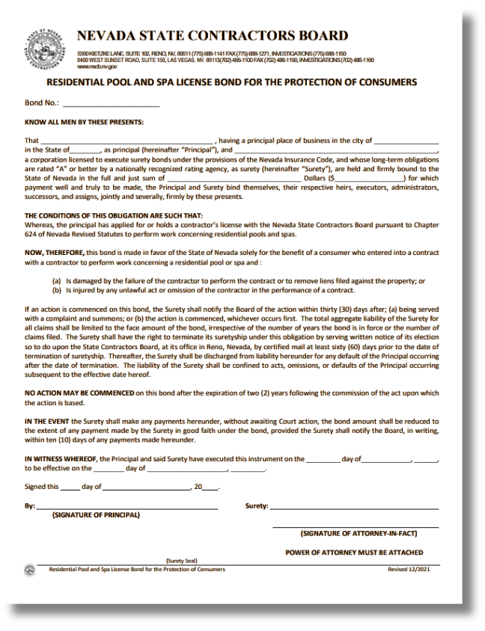
BOND REQUIREMENTS -
RESIDENTIAL
POOL & SPA
Bond Requirements
Residential Pool & Spa contractors may also be required to obtain a Consumer Protection Bond as a condition of licensure.
Residential Pool and Spa License Bond
PLEASE NOTE:
Failure to maintain the bond after the license is issued WILL result in suspension of that license.
24
Notes:
If your business plans to perform work involving residential pools or spas, additional licensing requirements may apply under NRS 624.900-965 and NAC 624.695-697.

Slide 25
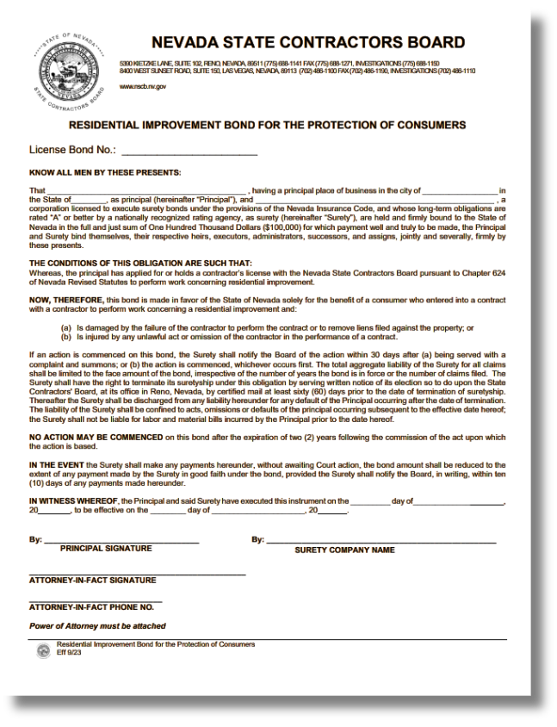
RESIDENTIAL IMPROVEMENT BOND
What is a Residential Improvement Bond?
  A bond SOLELY for the protection of consumers in the amount of $100,000.
  Can be posted making the provisions of AB 39, Section 1, Subsection 2(g) inapplicable.
Is a Residential Improvement Bond mandatory?
  No. However, if engaging in residential improvements, contractors MUST abide by the provisions of AB 39, Section 1, Subsection 2(g).
  Noncompliance with regulations is always subject to disciplinary action.
Residential Improvement Bond
25
Notes:
A residential improvement bond is held solely for the protection of the consumers in the amount of $100,000.
This bond type is not mandatory, however, if engaging in residential improvements, contractors must abide by provisions of AB 39, section 1, subsection 2g. Noncompliance with regulations is always subject to disciplinary action.

Slide 26
ASSEMBLY BILL 39
EFFECTIVE OCTOBER 1, 2023
What is AB 39?
  AB 39 authorizes the NSCB to adopt regulations establishing mandatory elements be included in contracts for work concerning certain residential improvements.
  AB 39's purpose is to establish a mandatory minimum set of requirements for all such contracts
What does it entail?
  Certain details must be included in contracts concerning residential improvements (see next slide, and AB 39, Section 1)
  Contractors may not request more than $1,000 or 10% of the aggregate contract price, whichever is less, for any initial down payment or deposit for work concerning residential improvements before the start of work (see AB 39, Section 1, Subsection 2(g)
To whom does it apply?
  Contractors engaging in residential improvements
Read the full text of AB 39 on our website:
www.nvcontractorsboard.com/wp-content/uploads/2023/10/AB39-Text.pdf
26
Notes:
AB 39 authorizes the Nevada State Contractors Board to establish regulations that require specific elements to be included in contracts for certain residential improvement projects.
The primary purpose of this bill is to ensure there is a consistent, mandatory set of minimum requirements across all applicable contracts, helping protect both homeowners and contractors.
It requires that certain key details be clearly outlined in contracts related to residential improvements. These required elements are further detailed in Section 1 of AB 39.
Additionally, the bill places limits on upfront payments. Contractors are not allowed to request more than one thousand dollars, or ten percent of the total contract price—whichever amount is less—as an initial deposit before any work begins.
AB 39 applies to contractors who engage in residential improvement projects.
Overall, this legislation promotes transparency, fairness, and accountability within residential contracting.”

Slide 27
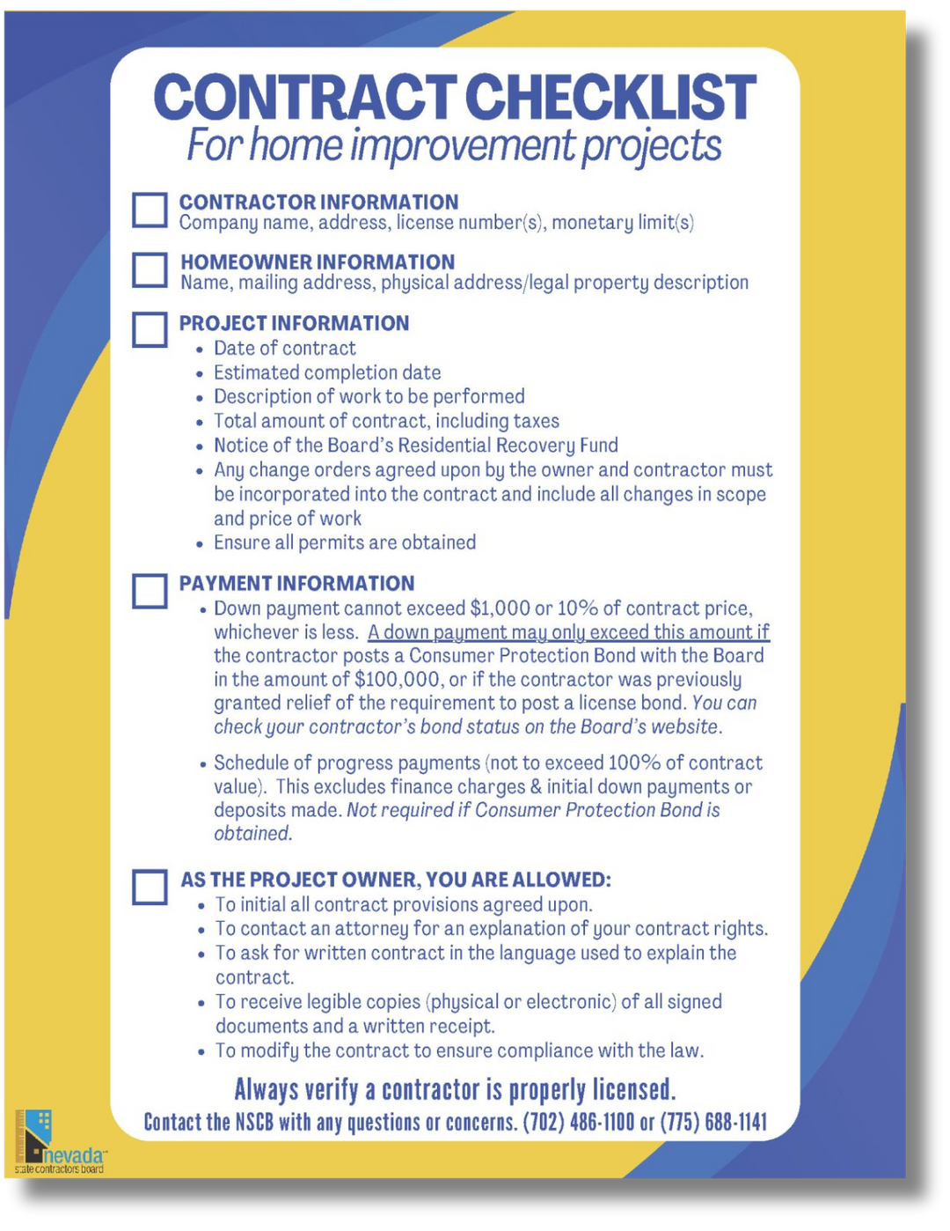
ASSEMBLY BILL 39
EFFECTIVE OCTOBER 1, 2023
Contract Checklist
  Outlines the mandatory minimum requirements established by AB 39
  A sample (downloadable) contract and contract outline can be found on our website:
www.nvcontractorsboard.com/resources
27
Notes:
Assembly Bill 39 introduced additional requirements for contractors. Applicants are encouraged to review the full legislation on the Nevada State Contractors Board website.

Slide 28
RESIDENTIAL RECOVERY FUND
The Residential Recovery Fund provides limited monetary compensation to single-family homeowners, under certain conditions, in the event that they have been damaged by a licensed contractor’s failure to appropriately execute a contract and after all other recovery options have been exhausted.
  Licensed contractors who engage in residential contracting pay a fee upon issuance and renewal of their contractor’s license to contribute to this fund’s availability;
  The amount contributed by the contractor to this fund is based on the monetary limit placed on their contractor’s license, as follows:
Assessment Based on the Monetary Limit of the License:
  Monetary limit of $1,000,000 or less: $80
  Monetary limit over $1,000,000, but NOT Unlimited: $200
  Monetary limit of Unlimited: $400
28
Notes:
The Residential Recovery Fund provides limited financial compensation to homeowners who experience financial loss due to a licensed contractor’s failure to meet contractual obligations. This fund is accessible for customers who meet the requirements and after all avenues of recovery have been exhausted. Contractors performing residential work must contribute to this fund when they receive or renew their license under NRS 624.470. The contribution amount is based on the contractor’s monetary limit.

Slide 29
RESIDENTIAL RECOVERY FUND
YOUR ROLE & RESPONSIBILITIES
  A residential contractor shall notify an owner with whom he or she contracts of the owner’s rights pursuant to NRS 624.400 to 624.560, inclusive, including, without limitation, by providing a written statement explaining those rights in any agreement or contract for qualified services.
  Written notice must also be provided to any homeowner entering into a contract regarding the existence of the Residential Recovery Fund.
CLAIMS PROCESS
  When a homeowner files a claim against the Residential Recovery Fund, Board staff will notify the contractor that an investigation has commenced regarding the allegations in the complaint seeking recovery.
  If a hearing is held, the Board will consider all matters relevant to the complaint before authorizing or denying payment by entry of a final order.
  The accused contractor may appear, or may be required to appear, before the Board to present evidence in support of or in defense of the claim.
  Any recovery fund fees paid as a result of an unlawful act by a licensed residential contractor must be reimbursed by the licensee.
  Licensees are responsible for reimbursing the Residential Recovery Fund for any claims awarded against their company.
29
PLEASE BE ADVISED
ALL PRINCIPALS, CMS QUALIFIERS AND TRADE QUALIFIERS ARE RESPONSIBLE FOR ANY COMPLAINTS RECEIVED ON A LICENSE!
Notes:
Nevada law also requires a specific disclosure about the recovery fund to be included in residential contractual agreements detailing the owner's rights.
In the scenario that a homeowner files a complaint against the recovery fund, board staff with notify the contractor about the open investigation concerning the allegations in the complaint. If a hearing is held, the board will consider all matter relevant to the complaint before issuing a decision.
The contractor may be required to appear before the board to present evidence in support of or in defense of the claim.
Any Residential Recovery Fund fees paid as a result of an unlawful act by a licensed residential contractor must be reimbursed by the licensee. Contractors are responsible for reimbursing the Fund for any claims awarded against their company.

Slide 30

RESIDENTIAL RECOVERY FUND
Required Notice for Residential Contracts
The statement below is required by Nevada law and MUST be included in all residential construction contracts pursuant to NRS 624.520. Please incorporate this language into your contracts and agreements with homeowners.
RESIDENTIAL CONSTRUCTION RECOVERY FUND
Payment may be available from the Recovery Fund if you are damaged financially by a project performed on your residence pursuant to a contract, including construction, remodeling, repair or other improvements, and the damage resulted from certain specified violations of Nevada law by a contractor licensed in this State. To obtain information relating to the Recovery Fund and filing a claim for recovery from the Recovery Fund, you may contact the State Contractors Board.
30
Notes:
The statement below is required by Nevada law and MUST be included in all residential construction contracts pursuant to NRS 624.520. Please incorporate this language into your contracts and agreements with homeowners.

Slide 31
REPORT UNLICENSED CONTRACTORS
Contracting Without a License is a CRIME!
NRS 624.700 – It is unlawful for any person or combination of persons to engage in the business or act in the capacity of a contractor within this state or submit a bid on a job situated within this state without having an active license.
  First offense - misdemeanor;
  Second offense - gross misdemeanor;
  Third offense - Class E felony.
Unlicensed Contractor Hotline:
Southern Nevada: (702) 486-1160 | Northern Nevada: (775) 688-1150
https://www.nvcontractorsboard.com/investigations/unlicensed-contractor-complaints/
31
Notes:
Contracting without a license is a crime per NRS 624.700. A first offense charge will result in misdemeanor, a second offense a gross misdemeanor and third offence is considered a class E felony. We encourage the public to utilize our unlicensed contractor hotline regarding any concerns.

Slide 32
HELPFUL RESOURCES
Nevada Small Business Development Center
(800) 240-7094
www.nevadasbdc.org
Nevada Secretary of State
(775) 684-5708
www.nvsilverflume.gov/startbusiness
PSI Exam Center
(800) 733-9267
www.psiexams.com
Nevada Division of Industrial Relations (DIR)
(702) 486-9000 or (775) 684-7270
www.dir.nv.gov
Helpful Resources, Hints and Tips
Tips for Nevada Licensed Contractors
Residential Recovery Fund Required Disclosures
General Contractor Required Disclosures
Pool Contracts Required Disclosures
Contract Checklist for Home Improvement Projects
Suggested Mandatory Language for Residential Improvement Contracts
Advertising Requirements
Complaint Forms
Contact the NSCB with any questions!
32
Notes:
Below, you’ll find helpful resources and links to other agencies that may be visited when making changes to your Nevada contractor license. Please contact that NSCB with any questions

Slide 33

IMPORTANT REMINDERS
BE TRUTHFUL
  Misrepresentation can be grounds for denial of your license.
REVIEW
  Review your application for accuracy and completeness;
  Ensure all documents are signed;
  Submitting a complete application is the best way to reduce delays in processing.
COMMUNICATION
  Communicate and respond to your license analyst in a timely manner.
  Email is always preferred; check your spam or junk folders often.
PROCESSING
  Applications are processed in the order received - “first come, first served.”
  Your patience is greatly appreciated!
33
Notes:
Important reminders to consider, please ensure to remain truthful as misrepresentation can result in the denial of changes to a license. Be sure to review your application prior to submittal as a complete application is the best way to reduce delays in processing. It’s important to communicate with your licensing analyst in a timely manner. Our processing timeframe is done on a first come, first served basis, therefore all applications are processed in date order received. Your patience is greatly appreciated.

Slide 34

QUESTIONS?
If you still have questions, please contact us by email or phone — we’ll be happy to assist you!
customerservice@nscb.state.nv.us
Southern Nevada
8400 West Sunset Road, Suite 150
Las Vegas, Nevada 89113
(702) 486-1100
Northern Nevada
5390 Kietzke Lane, Suite 102
Reno, Nevada 89511
(775) 688-1141
34
Notes:
If you have any questions during the application process, please contact the Nevada State Contractors Board for assistance. Our staff can help guide you through the requirements and support you through any changes in your Nevada Contractors license. Thank you for taking the time to review this guide, and best of luck in your contracting endeavors.

