Slide 1




NEVADA STATE CONTRACTORS BOARD
BUSINESS ASSISTANCE PROGRAM –
An online guide to help you navigate Nevada’s contractors license application requirements.
Step-by-step guidance for completing your contractor license application
Instructions for identifying license classifications and monetary limits
Trade and Management Qualified Individual requirements
Financial statement and background disclosure instructions
Tips for a complete and accurate application
Overview of fees, bonds, and insurance requirements
Residential Recovery Fund and AB 39 compliance information
Notes:
Welcome to the online business assistance program, a comprehensive guide on how to navigate Nevada's contractors license application.
In this presentation, we’ll walk through the key steps involved in the application process.
This includes how to choose the correct license classification, determine the appropriate monetary limit, and understand the requirements for trade and management qualifiers.
We’ll also cover financial statements, background disclosures, and helpful tips to make sure your application is complete prior to submittal.
In addition, we will review licensing fees, bonding and insurance requirements, the Residential Recovery Fund, and Assembly Bill 39 compliance.

Slide 2
DISCLAIMER
This resource contains general information about contractor applications, including legal guidelines, but it does not constitute definitive statements of the law and may not reflect the most current legal developments in the construction industry.
The information provided is not legal advice and is intended for informational purposes only.
For questions about how the law applies to specific situations, you should:
Consult an attorney familiar with Nevada law; or
Review the statutory and regulatory requirements under NRS Chapter 624 and NAC Chapter 624.
2
Notes:
Before we begin, please note that the information in this presentation is meant to provide general guidance about the contractor licensing process. It is not a legal interpretation of the law and may not reflect the most recent legal changes. The information here should not be considered legal advice.
If you have questions about how Nevada law applies to your situation, you may want to consult an attorney or review Nevada Revised Statutes Chapter 624 and Nevada Administrative Code Chapter 624.

Slide 3




OBTAIN A BUSINESS LICENSE
Register your business with the Secretary of State to obtain a Nevada Business ID.
Be sure to check for business name similarities before filing.
www.nvsilverflume.gov/startbusiness
(800) 450-8594
3
Notes:
The first step in the application process is obtaining a business license. To do this, you must register your business with the Nevada Secretary of State and obtain a Nevada Business ID. This service is accessible through their website, SilverFlume. Before submitting your registration, it’s important to check that your business name is not too similar to another existing business.

Slide 4
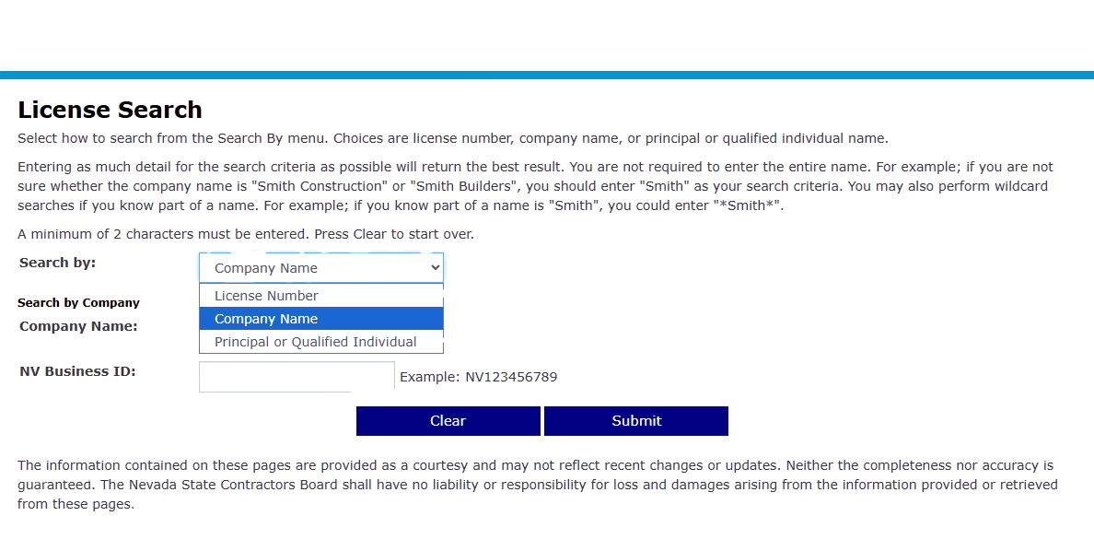

CHECKING FOR NAME SIMILARITIES WITH OTHER LICENSED CONTRACTORS
Business Name Similarities
Perform a license search on the NSCB website.
Company Name Search
Type in a business name for results.
Spelling Variations
Be sure to include variations in spelling, use of numbers or symbols:
  “I C U” vs. “I See You”
  “A to Z” vs. “A 2 Z”
  “Left and Right” vs. “Left & Right”
4
Notes:
When choosing a business name, make sure it is clearly different from names used by existing licensed contractors. Checking this early can help you avoid delays or possible rejection later in the process.

Slide 5


LICENSE CLASSIFICATION
Scope of Work
Determine the specific scope(s) of work you intend to perform.
View Classifications
Visit www.leg.state.nv.us/nac/nac-624 to view all license classifications (NAC 624.140 - NAC 624.858) and identify which fits best with the work you intend to perform.
Still Unsure?
If you’re unsure which classification you need, email
classdetermination@nscb.state.nv.us and describe your intended scope of work.
5
Notes:
After registering your business, the next step is determining the correct license classification. Nevada contractor licenses are divided into categories based on the type of work a contractor performs.
You can review all available classifications in Nevada Administrative Code Chapter 624.140 THROUGH 858.
If you are still unsure, you may email our class determination listed below with a detailed description of the trade work you intend on performing and they will help pinpoint the best classification for you in writing.

Slide 6

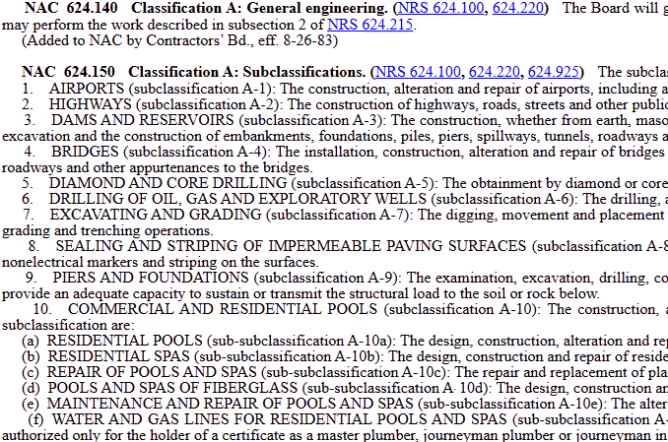

LICENSE CLASSIFICATION
LICENSE
Visit https://www.leg.state.nv.us/nac/nac-624 to search license classifications.
The list of classifications will look like this.
Scroll down to view all classifications and the work that can be performed by each.
6
Notes:
Our online classification summary include primary classifications and subclassifications that provide a description of the work you can do under each one. The following image provides an example of how our online classification summary appears on our website.

Slide 7

LICENSE
CLASSIFICATION
These are the subclassifications for the A General Engineering classification.
This is the
PRIMARY classification; e.g.:
A: General Engineering.
They provide limited scopes of work based on the subclassification license.
7
https://www.leg.state.nv.us/nac/nac-624
Notes:
For example, the A classification, known as General Engineering, includes several subclassifications that define more specific types of work.

Slide 8

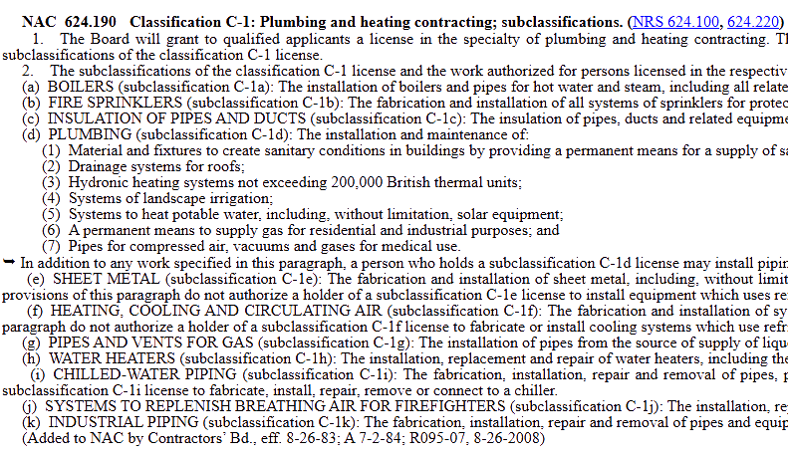

LICENSE CLASSIFICATION
The C Classifications are all specialty trades.
The PRIMARY classification is the bold header; e.g.:
C-1: Plumbing and Heating Contracting.
All work under this classification can be performed.
https://www.leg.state.nv.us/nac/nac-624
8
Notes:
C classifications typically cover specialty trades such as electrical, plumbing, and other skilled services. Once again, you may choose to apply for the full primary classification that will allow you to do all of the subtrades listed.

Slide 9

LICENSE CLASSIFICATION
The subclassifications of the primary classification are identified as:
(a) BOILERS
(b) FIRE SPRINKLERS ...
You can ONLY perform the
specific scope of work in the subclassification that you are applying for.
https://www.leg.state.nv.us/nac/nac-624
9
Notes:
If you’re interested in one of the subclassifications for example, plumbing, you may apply for the C-1D. You may only perform the specific scope of work in the subclassification that you are applying for.

Slide 10
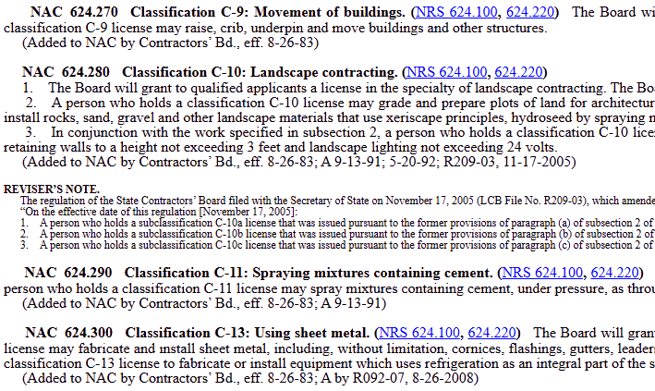
LICENSE CLASSIFICATION
Some classifications do not have subclassification categories.
Therefore, they only serve as a PRIMARY license classification.
https://www.leg.state.nv.us/nac/nac-624
10
Notes:
In our classification summary , you find that a few classifications may not have subclassifications therefore will only serve as a primary license. Choosing the correct classification is important to make sure you are properly licensed for the work your business plans to perform and which trade your application will be geared towards.

Slide 11

LICENSE CLASSIFICATION
Applying for Multiple PRIMARY Classifications?
Remember: the PRIMARY classification allows you to perform ALL work underneath that license.
If your work requires more than one primary license, you must submit a SEPARATE application for each primary license.
11
Notes:
Some applicants may want to apply for more than one classification. If you plan to apply for multiple primary license, there will be separate applications and a separate fee for each primary classification.

Slide 12
LICENSE CLASSIFICATION
Applying for Multiple SUBCLASSIFICATIONS?
Remember: a SUBCLASSIFICATION limits you to performing ONLY the work listed underneath that subclassification.
Subclassifications that fall under the same primary classification can be listed together on a single application.
Subclassifications that fall under a different primary classification must be listed on separate applications for each primary license.
12
Notes:
You are limited to performing work listed under the subclassification applied for. Please be sure to follow the same classification structure. For example, If you are applying for multiple subclassifications under the same primary trade that is one application and one fee. subclassifications that fall under different primary classifications must be listed on a separate application for each primary license.

Slide 13
LICENSE CLASSIFICATION
DID YOU KNOW?
If you are issued a license for a subclassification,
you can broaden the scope of the license to other subclassifications within the primary classification;
OR
expand the license to a full primary license.
(*if experience requirements have been met).
Requirements include submitting the Broadening of Classification form ($250 application fee) and all required documentation demonstrating the Trade Qualifier’s experience.
13
Notes:
if experience requirements are met, licenses issued for subclassifications may expand their scope to other subclassifications within the same primary license or broaden to the full primary classification.
The requirements for a Broadening of Classification include documentation of relevant experience for the trade qualifier, and a $250 application fee.

Slide 14


LICENSE CLASSIFICATION
LICENSE
SPECIAL NOTES REGARDING B CLASSIFICATION
Any B license project (General B or any of the B subclassifications) MUST include three (3) or more unrelated trades where the building or remodeling of a structure is the primary purpose.
B license holders CANNOT self-perform electrical, HVAC, fire protection or plumbing unless they obtain the specialty license. This includes any of the subclassifications under the B license.
Work Certificates and Resume for the General B or B-2 must show experience in the construction of buildings, not just remodeling or additions.
General B Classification scope includes work in structures over three (3) stories; a B-2 classification cannot exceed three (3) stories tall or one (1) story below ground.
Minimum monetary limit at this time for General B and B-2 licenses is $200,000.00.
14
For projects that don’t involve ground-up construction, you may want to consider our B-6 (Commercial Remodeling) or B-7 (Residential Remodeling) license classifications.
Notes:
The B classification generally applies to building construction. that includes three or more unrelated trades. Per statute, B license holders cannot self perform electrical, HVAC, fire protection or plumbing unless they obtain these specialty licenses. This applies to any of the subclassifications under the B license. All General B and B-2 classifications must show experience in the construction of buildings from the ground up for at least four full years or more, not just in remodeling or additions. The General B classification requires construction on structures over 3 stories above the ground whereas the B-2 classification is geared towards residential and small commercial that cannot exceed three stories tall or one story below the ground. The minimum monetary limit for both the general B and B-2 is $200,000. For projects that do not include ground up construction, you may reference our B-6 (Commercial Remodeling) or B-7 (Residential Remodeling) license classifications.

Slide 15



NEW
-
RESTRICTED LICENSE
The Nevada State Contractors Board has introduced a NEW B-7 Restricted License Classification for Residential Remodeling!
Contracting under this classification is limited to the remodeling and improvement of:
an existing, detached, stand-alone single-family residence; or
a single-family residential unit within a structure that does not extend more than three (3) stories above the ground and/or one (1) story below ground.
The new B-7 classification does not authorize a contractor to increase the existing, enclosed space of the residential structure.
A person who has held a restricted license for a period of two (2) years or more may apply for a full, unrestricted contractor’s license if the person is not the subject of any open or unresolved complaints.
15
Notes:
the new b-7 restricted classification is designated for Residential Remodeling. This license allows contractors to perform residential remodeling work on existing, detached, stand alone single family residences or
a single family residential unit within a structure that does not extend more than 3 stories above the ground and or 1 story below ground. The B-7 does not authorize the increase of an existing living space, it is strictly to remodel the existing residential structure

Slide 16


APPLYING
FOR A
-
RESTRICTED LICENSE
Gain valuable trade experience!
Apply for a full license after two (2) years.
Increase value of projects from $1,000 to $7,000.
Requirements:
(This restricted license cannot exceed the $7,000 monetary limit.)
At least two (2) years of experience in a trade, which may include:
  work experience of a particular type or within a particular classification;
  alternative training in a program recognized by the Board;
  completion of any other program or obtaining any other qualification acceptable to the Board.
Within a year immediately preceding the date on which the application is submitted, complete a course in business counseling - or a similar curriculum - which consists of any other requirements established by the Board.
Payment of any required fees for the issuance of the license.
Obtain a surety or cash bond in the amount of $2,000.
16
Notes:
Our new restricted license will allow contractors to gain valuable trade experience, apply for a license after two years, and increase the monetary value of projects from $1,000 to a maximum of $7,000.
The requirements are as described:
at lest two years of work experience of a particular type or classification...
a business course must be completed current within one year of the application date - or a similar curriculum that meets the requirements established by the board.
payment of any required fees for the issuance of the license
a surety bond in the amount of $2,000

Slide 17


PRINCIPALS
The following principal types need to be listed on the license application (section 4) based on your business entity type:
CORPORATION:
ALL Officers listed with the Nevada Secretary of State (President, Secretary, Treasurer)
SOLE PROPRIETOR:
Individual person applying (sole owner)
GENERAL PARTNERSHIP:
ALL partners
LIMITED PARTNERSHIP:
ALL partners
LIMITED LIABILITY COMPANY:
ALL managers or managing members with managing authority
PLEASE BE ADVISED
ALL PRINCIPALS, CMS QUALIFIERS AND TRADE QUALIFIERS
ARE RESPONSIBLE FOR ANY COMPLAINTS RECEIVED ON A LICENSE!
17
Notes:
Depending on the structure of your business, certain individuals must be listed in section four of the application.
For a corporation, that would include your president, secretary, treasurer.
If you're a limited liability company this includes your managers, managing members or members.
Sole proprietorships are single person companies that consist of the individual owner.
General partnerships include the registration of your general partners, your limited partners or whoever you may register with the Secretary of State

Slide 18

QUALIFIED INDIVIDUALS
MANAGEMENT
TRADE
  REQUIRED to take and pass the business and law exam, referred to as the CMS Exam.
  REQUIRED to take and pass applicable trade-specific exam(s).
  MUST demonstrate four (4) years of experience within the classification, within the last fifteen (15) years.
  Experience should be of journeyman, foreman, supervising employee or contractor level.
18
PLEASE BE ADVISED
ALL PRINCIPALS, CMS QUALIFIERS AND TRADE QUALIFIERS
ARE RESPONSIBLE FOR ANY COMPLAINTS RECEIVED ON A LICENSE!
Notes:
Each contractor license must also identify qualified individuals, on the application you will choose a management law qualifier and a trade qualifier. This can be the same person, or 2 different individuals. While there are no requirements for who takes the law exam, trade qualifiers must demonstrate the 4 years of experience at the journeyman, foreman, or supervisory level in the applying classification within the last 15 years.
Again, principals and qualifiers share responsibility for maintaining compliance with licensing requirements.

Slide 19

QUALIFYING EXPERIENCE
Four (4) Certificate of Work Experience forms and
Resume of Experience (attachments A & B) are required.
Identifies the work experience of the TRADE QUALIFIER.
  Certificates can include work performed in states other than Nevada.
Each form must be completed by the person confirming the work performed.
  This may include current or former employers, homeowners, business clients, partners, etc.
  Family members are NOT PERMITTED unless they served as the trade qualifier’s employer.
  Forms CANNOT be completed by the trade qualifier themselves.
  Certificates should be completed by four (4) different companies/certifiers.
Each certificate should detail the work performed as it relates to the classification being applied for.
Must demonstrate four (4) years of experience within the past fifteen (15) years.
19
Notes:
The required documents detailing the trade qualifier’s work experience consist of 4 certification of work experience forms & a resume . The qualifier may fill out the resume giving us a work history of the trade they’re applying for, the timeframes and a detailed description of the work they have performed.
The certificates must be completed by someone who can confirm your work experience, such as past or current employers, other subcontractors they may have worked with, as well as clients that may verify projects performed by the trade employee. These forms may include work performed in Nevada or out of state.
Family members may only complete these forms if they were the applicant’s employer. The trade qualifier cannot complete the forms themselves. Applicants must submit four certificates from four different certifiers with a detailed description of the type of work performed, along with a resume showing their experience .Please note that these forms must come from 4 different sources, not the same individual or company. The four submitted forms should equate to a cumulative of 4 full years or more documented experience within the past fifteen years.

Slide 20
QUALIFYING EXPERIENCE
Current Master’s Certification
  Provide a copy of the certification with your application.
Military Experience and Training
  Contact one of our Veteran, Military Spouses and Training Program coordinators to see how your military training and experience can be used to meet license experience requirements.
Greg Owen: (702) 486-1107 | Lisa Bedsole: (702) 486-1120
Educational and Related Training Experience
  Provide documentation regarding completed courses or programs with the application.
  Staff will review and determine the experience that qualifies.
20
Notes:
If you are applying for the C-1 Plumbing or C-2 electrical trade and you hold a current master certification, you may include a copy of the signed masters card in your application. While this waives the four work certifications, you will still be required to submit the resume of experience.
If you have any qualifying military experience in training, you may submit a description of relevant job duties during your service. Feel free to contact our office and speak to our veteran, military spouses, and training program coordinator if you have any questions about your trade experience in the military and how you can apply it to our application.
Any educational and related training experience may be submitted and reviewed on a case by case basis. Work certificate forms will still be required to contribute to the full 4 years of experience.

Slide 21

EXAMINATION REQUIREMENTS
Exams cannot be taken until AFTER the application has been submitted.
The NSCB will issue an exam eligibility letter upon submission of your application, which contains a Candidate ID number.
Those required to take an exam will need to schedule a time to take the exam by contacting PSI directly.
PSI will provide the cost of the exam(s) and all study/reference materials, which can be accessed at any time.
www.psiexams.com | (855) 205-5827
21
Notes:
PSI exam center administers all licensing exams. However, the exam cannot be taken until after the application has been submitted. Once your application is received, the Nevada State Contractors Board will send you an exam eligibility letter that includes your candidate identification number.
You will then schedule your exam directly with PSI Examination Services. PSI provides information about exam fees, study materials, and reference guides.

Slide 22

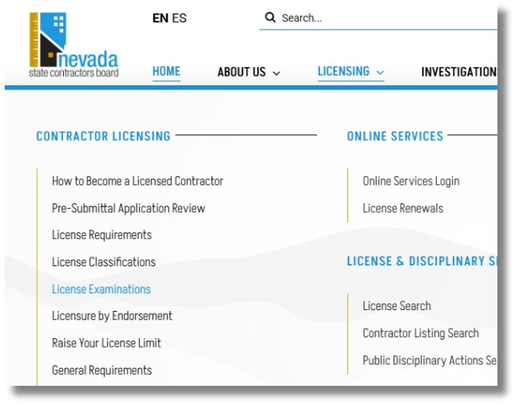
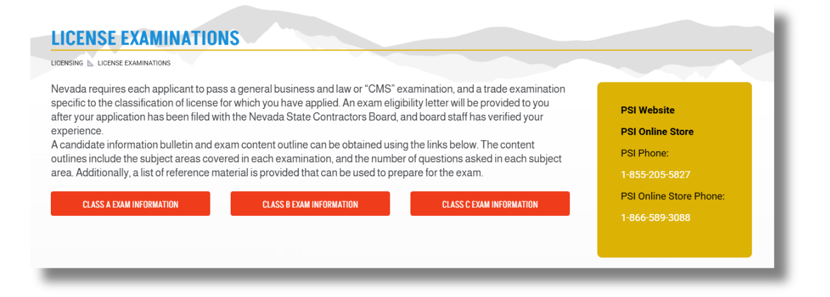
EXAMINATION REFERENCE MATERIAL
ACCESSING EXAM INFORMATION
22
Notes:
You may utilize the license examination tab on our website to view the candidate information bulletin and other tabs related to PSI

Slide 23
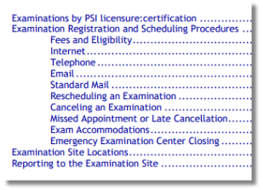
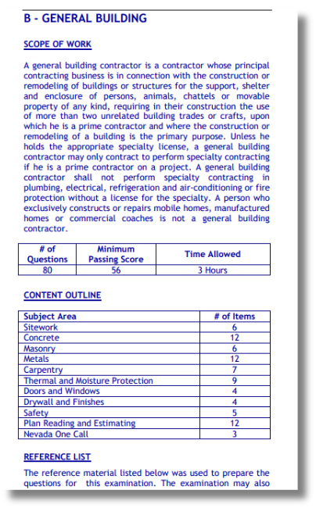
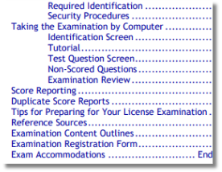
EXAMINATION REFERENCE MATERIAL
The Candidate Information Bulletin provides the following:
  Number of questions
  Minimum Passing Score
  Time Allowed
  Number of questions per subject area
23
Notes:
Their Candidate Information Bulletin outlines the exam format, number of questions, passing score, time limits, and subject areas. You will have 6 months from the date the application is received to complete all testing.

Slide 24
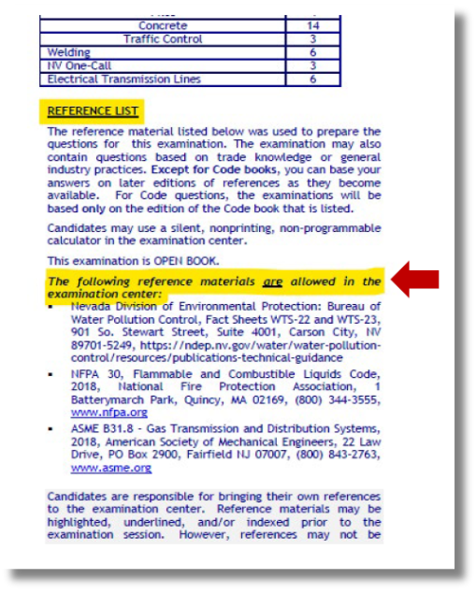
EXAMINATION REFERENCE MATERIAL
Are study materials or practice examinations available?
  Each downloadable Exam Information Bulletin includes a list of reference materials that may be used to prepare for the examination.
NOTE: The NSCB does not administer testing nor provide any testing materials.
24
Notes:
Each exam information bulletin includes a list of reference material available to prepare for the examination. The Nevada State Contractors Board does not administer the exam or provide testing materials.

Slide 25
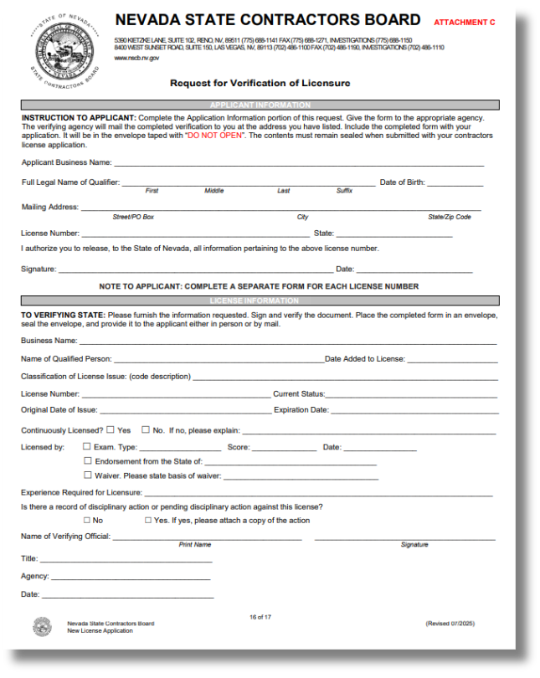
LICENSURE BY ENDORSEMENT
ENDORSEMENT OF TRADE EXAM AND/OR EXPERIENCE REQUIREMENTS
  Must be actively licensed in participating state for the past four (4) years without lapse;
  Must not have had any disciplinary action taken against the license during that time;
  Must have taken and passed equivalent trade exam.
IF YOU BELIEVE YOU QUALIFY:
  The Verification of License form (attachment C included in the application) must be completed by the agency responsible for the out-of-state license;
  CMS Exam is still required for Management Qualified Individual;
  A completed Resume of Experience is required in support of the classification you are applying for.
25
https://www.nvcontractorsboard.com/licensing/licensure-by-endorsement/
Notes:
Licensure by endorsement provides the opportunity of using an equivalent trade exam passed in an endorsing state to meet the trade exam or experience requirements in Nevada. You must be licensed for the past 4 years in the participating endorsing state without lapse or disciplinary actions.
To qualify, you must submit a request for ‘verification of licensure’ form included in section 9 of the application. This form is completed by the agency responsible for the out of state license. Once the form is completed, you will receive a sealed envelope that must be included with your application upon submittal. Please refrain from opening the sealed envelope but you may keep the copy included for your records. Endorsement is used only for the waiver of a trade exam, the business and law exam must be taken. With this, you are still required to submit a resume of experience showcasing 4 years or more in the applied trade.

Slide 26

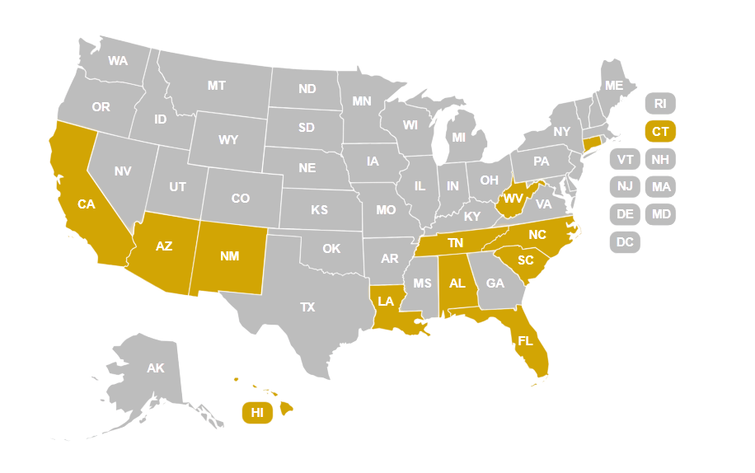
LICENSURE BY ENDORSEMENT
ENDORSEMENT OPPORTUNITIES AVAILABLE
  Alabama
  Arizona
  California
  Connecticut
  Florida
  Hawaii
  Louisiana
  New Mexico
  North Carolina
  South Carolina
  Tennessee
  West Virginia
26
https://www.nvcontractorsboard.com/licensing/licensure-by-endorsement/
Notes:
The following states are the acceptable endorsing opportunities available. This process is specific to certain trades for the following states, please check our state equivalency chart under licensing to see if your trade is applicable.

Slide 27


NASCLA ACCREDITED EXAM
Applying for a B or B-2 Classification?
  You may qualify for waiver of the trade exam if you have passed the National Association of State Contractor Licensing Agencies (NASCLA) accredited general building exam.
  Certificates of Work Experience forms and Resume of Experience will still be required with application.
REQUIRED:
  You will need to purchase and electronically send your transcript to the Nevada State Contractors Board.
27
Notes:
Some applicants may qualify to waive the trade exam on the passing of the NASCLA Accredited Examination if you are applying for the B OR B-2 Classification. Please provide a copy of the NASCLA transcript with your application. The submission of four work certificates and a resume is still required to showcase experience.

Slide 28



APPLICANT
DISCLOSURES
ALL persons listed on the application (Principals, Officers and Qualified Individuals) are REQUIRED to submit the following:
Applicant Background Disclosure form
Fingerprint Background Waiver
Copy of a VALID driver’s license or government-issued ID
** If you are applying as a SOLE PROPRIETOR and are married, your spouse must also:
Complete the Applicant Background Disclosure form; and
Provide a copy of a valid driver’s license or government-issued ID
28
Notes:
All applicants must complete an Applicant Background Disclosure form, the fingerprint background waiver form and provide a copy of a valid driver’s license or government-issued identification.

Slide 29
FINGERPRINT
REQUIREMENTS
  All persons listed on the license are required to submit fingerprints.
  Instructions on how to obtain fingerprints will be given once the application has been submitted and reviewed by Board staff.
  Do NOT submit fingerprints prior to submitting your application.
29
Notes:
All individuals on the license will be required to submit fingerprints. Fingerprint instructions will be provided to the email address on record after your application is submitted.
Please do not submit fingerprints prior to the submittal of your application

Slide 30

MONETARY LIMIT
Every contractor’s license has a MONETARY LIMIT.
The monetary limit is the MAXIMUM value of one or more construction contracts that a licensed contractor may undertake for a single client on a single construction site or subdivision site.
You may NOT bid or contract for any amount that exceeds your monetary limit or the contract will be void. (NRS 624.640)
DETERMINING YOUR LICENSE LIMIT
  Consider the average contract value of work you intend to perform, including change orders;
  Contract values cannot exceed the monetary limit of your license;
  The monetary limit you request may not be the limit you qualify for once financial statements are reviewed.
30
Notes:
Each contractor license has a monetary limit. This limit determines the maximum value of a project that a contractor can undertake for a single client on a single construction site or subdivision. Once the set amount is decided, this will determine the type of financials you will provide with the application.

Slide 31
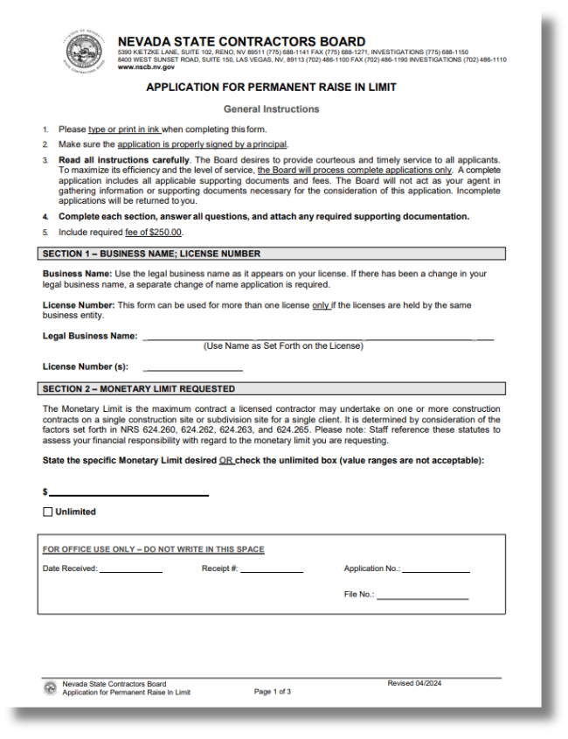
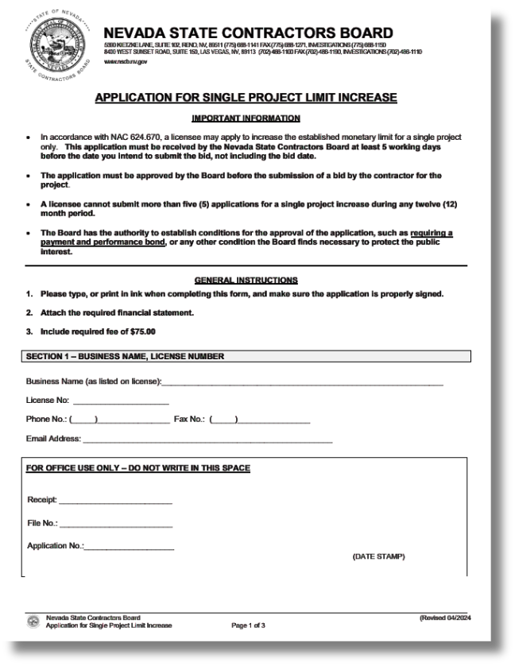
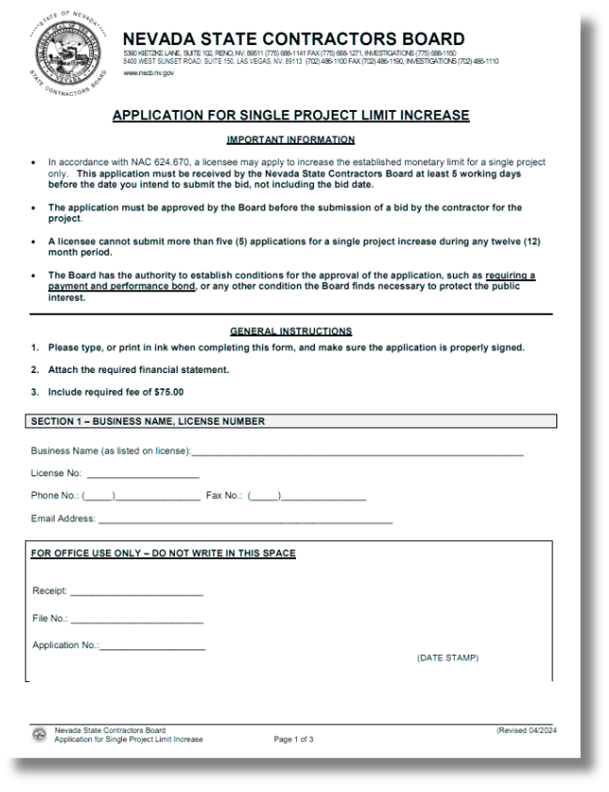

MONETARY LIMIT
DID YOU KNOW?
Upon receiving your contractor’s license, you can increase the monetary limit of your license by submitting both an application to raise your limit and an updated financial statement that supports the new, requested limit.
Single Project Limit Increase application
- one-time limit increase that applies to a SPECIFIC project
- can be requested up to five (5) times in a 12-month period
- must be received by the Board at least five (5) business days prior
to the bid date
Permanent Raise in Limit application
- permanently increases your license monetary limit for all future
projects
31
Notes:
After receiving a license, contractors may request a higher monetary limit by submitting updated financial documentation that support the new requested limit.
There are two types of increases: a single project limit increase or a permanent increase to the license limit. A single raise in limit is job specific and a one time increase to allow you to bid on a project that is over that set limit. This can be requested up to 5 times in a 12 month period and must be received by the Board at least 5 working days prior to the bid date.
A permanent raise in limit will allow you to permanently increase your limit for future jobs set at the cap. Both of these applications will require new financial statements.

Slide 32
FINANCIAL REQUIREMENTS
As part of the application process, a business financial statement (in US dollars) is REQUIRED for the applying entity.
The type of financial statement required is based on the monetary limit requested for the license:
MONETARY LIMITS OF 25,000 OR LESS:
  A current financial statement prepared by an independent Certified Public Accountant; or
  A current financial statement submitted on a Board-approved form (available at our office or on our website); or
  A current financial statement (Balance Sheet) prepared using accounting software in accordance with generally accepted accounting principles.
MONETARY LIMITS OF $25,001 OR MORE, BUT LESS THAN $500,000:
  A compiled financial statement prepared by an independent Certified Public Accountant current within six (6) months from the date the application is received; or
  A financial statement reviewed or audited by an independent Certified Public Accountant current within one (1) year from the date the application is received.
MONETARY LIMITS OF $500,001 OR MORE, BUT LESS THAN $1,000,000:
  A compiled financial statement, with full disclosures, prepared by an independent Certified Public Accountant current within six (6) months from the date the application is received; or
  A financial statement reviewed or audited by an independent Certified Public Accountant current within one (1) year from the date the application is received.
MONETARY LIMITS OF $1,000,001 OR MORE:
  A financial statement that is prepared and reviewed or audited by an independent Certified Public Accountant current within one (1) year from the date the application is received.
32
Notes:
Applicants must submit all business financial statement in U.S. dollars. The type of financial statement required will depend on the monetary limit requested for the license. For example, if you’re aiming for a limit of $10,000 you may submit a self prepared financial statement using our board-approved form on our website or an accounting software in accordance with generally accepted accounting principles. All CPA compiled statements must be current within 6 months from the date the applications is received while reviewed or audited financial statements prepared by an independent CPA are current within one year from the date the application is received.

Slide 33
RESIDENTIAL RECOVERY FUND
The Residential Recovery Fund provides limited monetary compensation to eligible single-family homeowners who have been financially harmed by a licensed contractor’s failure to properly perform under a contract, after all other avenues of recovery have been exhausted.
  Contractors performing qualified services on residential properties are REQUIRED under NRS 624.470 to pay an assessment into the Residential Recovery Fund at the time of licensure and at the time of renewal (every two (2) years).
  The assessment amount is based on the monetary limit of the contractors license:
Monetary Limit Residential Recovery Fund Assessment
$1,000,000 or less $80
Over $1,000,000, but NOT Unlimited $200
Unlimited $400
Note: If you are only performing work on commercial properties, the Recovery Fund assessment is not required.
33
Notes:
The Residential Recovery Fund provides limited financial compensation to homeowners who experience financial loss due to a licensed contractor’s failure to meet contractual obligations. This fund is accessible for customers who meet the requirements and after all avenues of recovery have been exhausted. Contractors performing residential work must contribute to this fund when they receive or renew their license under NRS 624.470. The contribution amount is based on the contractor’s monetary limit.

Slide 34
RESIDENTIAL RECOVERY FUND
NOTIFICATION REQUIREMENTS
  A residential contractor must notify any homeowner with whom they contract of the owner’s rights under NRS 624.400 to 624.560. This includes providing a written statement explaining those rights in any agreement or contract for qualified services.
  Contractors must also provide written notice to any homeowner regarding the existence of the Residential Recovery Fund.
YOUR ROLE & RESPONSIBILITIES
  When a homeowner files a claim against the Residential Recovery Fund:
  Board staff will notify the contractor that an investigation has been opened concerning the allegations in the complaint.
  If a hearing is held, the Board will consider all matters relevant to the complaint before issuing a final order to authorize or deny payment.
  The contractor may be required to appear before the Board to present evidence in support of or in defense of the claim.
  Any Residential Recovery Fund fees paid as a result of an unlawful act by a licensed residential contractor must be reimbursed by the licensee. Contractors are responsible for reimbursing the Fund for any claims awarded against their company.
34
PLEASE BE ADVISED
ALL PRINCIPALS, CMS QUALIFIERS AND TRADE QUALIFIERS ARE RESPONSIBLE FOR ANY COMPLAINTS RECEIVED ON A LICENSE!
Notes:
Nevada law also requires a specific disclosure about the recovery fund to be included in residential contractual agreements detailing the owner's rights.
In the scenario that a homeowner files a complaint against the residential recovery fund, board staff with notify the contractor about the open investigation concerning the allegations in the complaint. If a hearing is held, the board will consider all matter relevant to the complaint before issuing a decision.
The contractor may be required to appear before the board to present evidence in support of or in defense of the claim.
Any Residential Recovery Fund fees paid as a result of an unlawful act by a licensed residential contractor must be reimbursed by the licensee. Contractors are responsible for reimbursing the Fund for any claims awarded against their company.

Slide 35

RESIDENTIAL RECOVERY FUND
Required Notice for Residential Contracts
The statement below is required by Nevada law and MUST be included in all residential construction contracts pursuant to NRS 624.520. Please incorporate this language into your contracts and agreements with homeowners.
RESIDENTIAL CONSTRUCTION RECOVERY FUND
Payment may be available from the Recovery Fund if you are damaged financially by a project performed on your residence pursuant to a contract, including construction, remodeling, repair or other improvements, and the damage resulted from certain specified violations of Nevada law by a contractor licensed in this State. To obtain information relating to the Recovery Fund and filing a claim for recovery from the Recovery Fund, you may contact the State Contractors’ Board.
35
Notes:
The statement below is required by Nevada law and MUST be included in all residential construction contracts pursuant to NRS 624.520. Please incorporate this language into your contracts and agreements with homeowners.

Slide 36
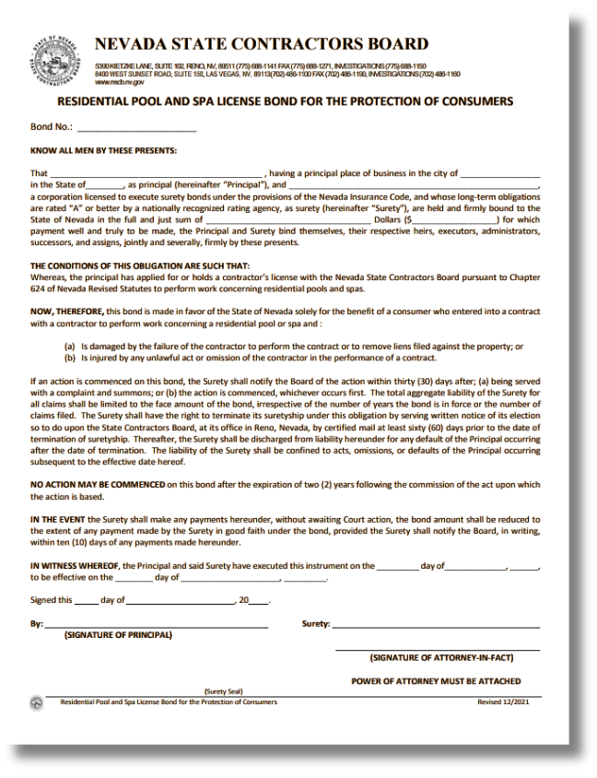

RESIDENTIAL POOL & SPA
Will you be performing work on residential pools and spas?
Become familiar with the enhanced statutory/regulatory requirements for consumer protection under NRS 624.900-965 and NAC 624.695-697.
Bond Requirements
Residential Pool & Spa contractors may also be required to obtain a Consumer Protection Bond as a condition of licensure.
36
Notes:
If your business plans to perform work involving residential pools or spas, additional licensing requirements may apply under NRS 624.900-965 and NAC 624.695-697.

Slide 37
BOND REQUIREMENTS
Bond Requirements
Bond requirements are established by the Board based on:
  Type of License
  Monetary Limit
  Financial Responsibility
  Experience
Types of Bonds
  Surety Bond
  Cash Bond Deposit (*biennial service fee of $200 upon license renewal)
  Residential Improvement Bond (*per Assembly Bill 39, effective October 1, 2023)(more info next slide)
Bond Amounts
  Bonds may range in value from $1,000 to a maximum of $500,000
  The bond amount may require adjustment after a raise in limit
37
PLEASE NOTE:
Failure to maintain the bond after the license is issued WILL result in suspension of that license.
Notes:
Bond limits are determined by the type of license, monetary limit, and financial responsibility
The surety bond is the general requirement for contractors in Nevada. You may have the option of a cash bond with service fee of $200 upon license renewal
As well as a residential improvement bond per assembly bill 39.

Slide 38
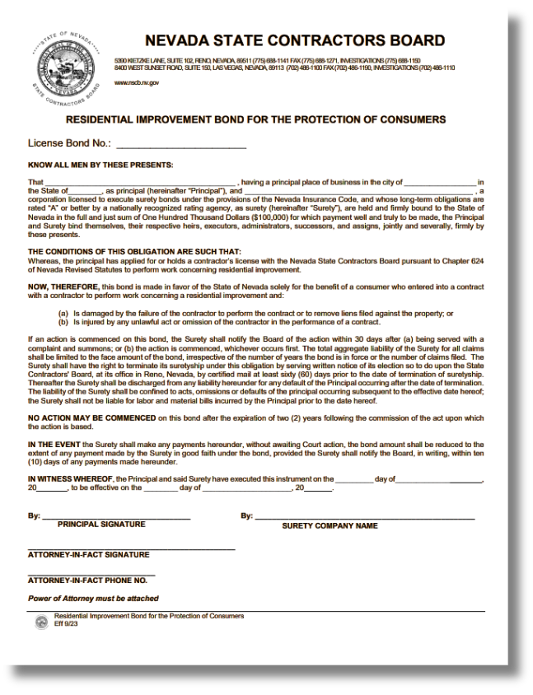
RESIDENTIAL IMPROVEMENT BOND
What is a Residential Improvement Bond?
  A bond SOLELY for the protection of consumers in the amount of $100,000.
  Can be posted making the provisions of AB 39, Section 1, Subsection 2(g) inapplicable.
Is a Residential Improvement Bond mandatory?
  No. However, if engaging in residential improvements, contractors MUST abide by the provisions of AB 39, Section 1, Subsection 2(g).
  Noncompliance with regulations is always subject to disciplinary action.
38
Notes:
A residential improvement bond is held solely for the protection of the consumers in the amount of $100,000.
This bond type is not mandatory, however, if engaging in residential improvements, contractors must abide by provisions of AB 39, section 1, subsection 2g. Noncompliance with regulations is always subject to disciplinary action.

Slide 39
ASSEMBLY BILL 39
EFFECTIVE OCTOBER 1, 2023
What is AB 39?
  AB 39 authorizes the NSCB to adopt regulations establishing mandatory elements be included in contracts for work concerning certain residential improvements.
  AB 39's purpose is to establish a mandatory minimum set of requirements for all such contracts.
What does it entail?
  Certain details must be included in contracts concerning residential improvements (see next slide, and AB 39, Section 1).
  Contractors may not request more than $1,000 or 10% of the aggregate contract price, whichever is less, for any initial down payment or deposit for work concerning residential improvements before the start of work (see AB 39, Section 1, Subsection 2(g).
To whom does it apply?
  Contractors engaging in residential improvements.
Read the full text of AB 39 on our website:
www.nvcontractorsboard.com/wp-content/uploads/2023/10/AB39-Text.pdf
39
Notes:
AB 39 authorizes the Nevada State Contractors Board to establish regulations that require specific elements to be included in contracts for certain residential improvement projects.
The primary purpose of this bill is to ensure there is a consistent, mandatory set of minimum requirements across all applicable contracts, helping protect both homeowners and contractors.
It requires that certain key details be clearly outlined in contracts related to residential improvements. These required elements are further detailed in Section 1 of AB 39.
Additionally, the bill places limits on upfront payments. Contractors are not allowed to request more than one thousand dollars, or ten percent of the total contract price—whichever amount is less—as an initial deposit before any work begins.
AB 39 applies to contractors who engage in residential improvement projects.
Overall, this legislation promotes transparency, fairness, and accountability within residential contracting.”

Slide 40
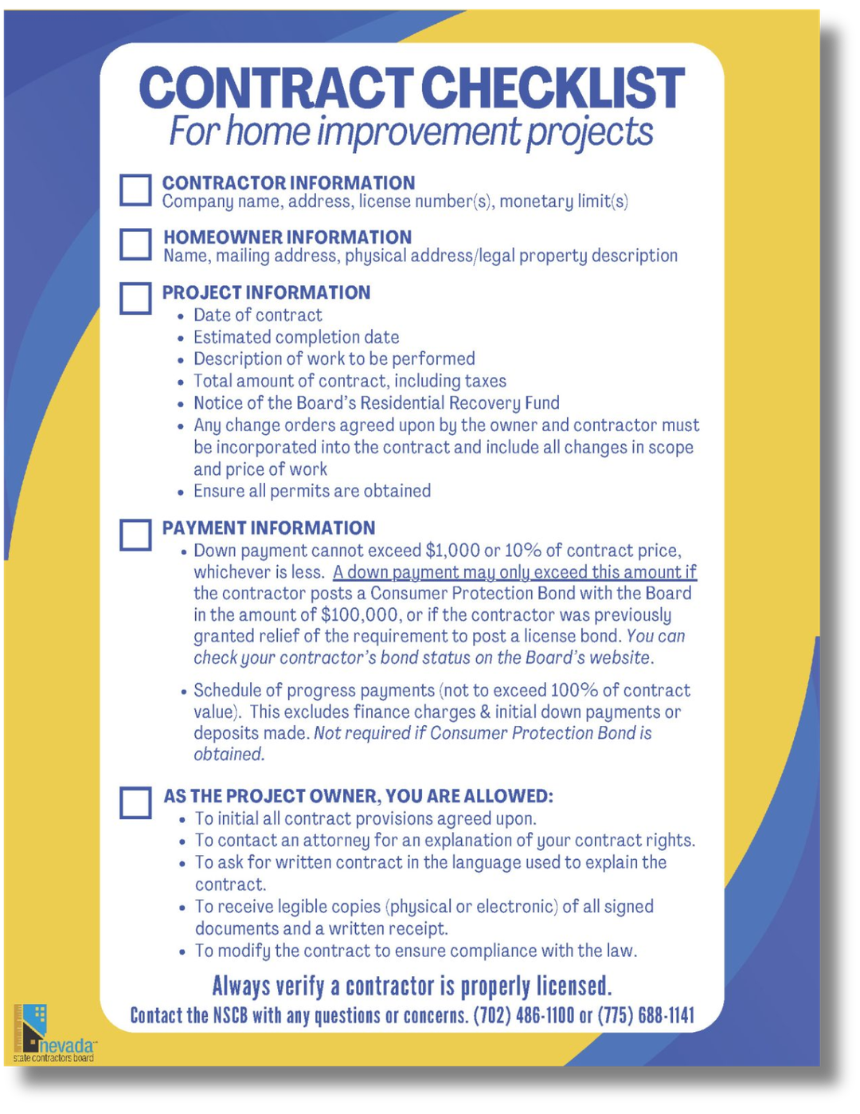
ASSEMBLY BILL 39
EFFECTIVE OCTOBER 1, 2023
Contract Checklist
  Outlines the mandatory minimum requirements established by AB 39.
  A sample contract and contract outline (downloadable) are available on our website:
www.nvcontractorsboard.com/resources
40
Notes:
Assembly Bill 39 introduced additional requirements for contractors. Applicants are encouraged to review the full legislation on the Nevada State Contractors Board website.

Slide 41

INDUSTRIAL INSURANCE
Prior to receiving a license, applicants MUST:
  provide proof of coverage for Workers’ Compensation Insurance; or
  submit an Affidavit of Exemption form.
  Once the license is issued, you will be required to provide proof of coverage at the time of each renewal.
www.dir.nv.gov
Northern Nevada: (775) 684-7270 | Southern Nevada: (702) 486-9000
41
Notes:
Before a contractor license can be issued, applicants must provide proof of workers’ compensation insurance. If your business qualifies, you may instead submit an Affidavit of Exemption. Proof of coverage must also be provided again during each license renewal.

Slide 42
REVIEW OF COSTS
  Application Fee: $300 (non-refundable)
  License Fee: $600 (due at the time of licensure and every two (2) years thereafter to maintain an active license)
  Residential Recovery Fund Assessment (if applicable):
- $80, $200, or $400, depending on the license monetary limit
Additional Considerations & Costs
  Registering your business with the Nevada Secretary of State
  Obtaining financial statements
  Taking required exams
  Meeting bond requirements
  Meeting Workers’ Compensation Insurance requirements
(not an all-inclusive list)
42
Notes:
At this stage, applicants should review all costs associated with the licensing process to ensure they are prepared for each requirement.

Slide 43

LET’S RECAP!
  Register with the Nevada Secretary of State.
  Check for business name similarities with the NSCB and Secretary of State.
  Identify the license classification(s) and monetary limit you need.
  Determine the Trade and Management Qualified Individuals for each license.
  Have each person listed on the license complete:
1. Application Background Disclosure form
2. Fingerprint Background Waiver
3. Include a copy of their ID
  Complete the financial statement requirement.
  Review all information for accuracy and ensure all required areas are signed by the appropriate person.
  Submit your application along with a $300 check payable to NSCB.
* Online application now available.
  Download study materials from PSI to prepare for the exam, if needed.
43
Notes:
Let’s quickly review the main steps in the process.
First, register your business with the Nevada Secretary of State.
Next, check for name similarities.
Then choose the correct license classification and monetary limit.
Identify your Trade and Management Qualified Individuals.
Complete all background disclosure and fingerprinting forms.
Prepare your financial statement. Finally, review your application carefully and submit it with the $300 application fee. If required, download exam study materials from PSI.

Slide 44
READY TO SUBMIT YOUR APPLICATION?
WHAT TO EXPECT
TIPS FOR A STREAMLINED APPLICATION PROCESS
  Submission: Applications and fees may be submitted online, by mail, or in person.
  Assignment: Once received, your application will be assigned to a license analyst.
  Processing: Analysts review applications in the order received, on a first-come, first-served basis.
  Notification: When your application is opened for review, you may receive written notice by mail, email, or both. This notice will:
- Identify any additional information
required
- Specify further actions needed to
continue processing
- Include applicable due dates
  Point of Contact: The analyst reviewing your application will serve as your primary contact throughout the remainder of the application process.
  Complete Your Application: Ensure all sections are filled out accurately. Do not leave any fields blank, unchecked, or omitted.
  Respond Promptly: If you receive notice that additional information or action is required, provide the requested materials as soon as possible. Allow sufficient time to gather everything and meet the stated due dates.
  Mandatory Requirements: Any information requested by an analyst is required to complete your application. These requirements are not negotiable, as they are mandated by statute or Board policy. Applications may be withdrawn if required materials are not submitted on time.
  Ask Questions Early: If you are unsure about any part of the application, contact a customer service representative before submission to ensure your application is complete and accurate.
44
Notes:
If you have completed these steps, you are ready to submit your contractor license application. Once received, your application will be assigned a licensing analyst.
All applications are processed in date order received a first-come first-served basis. When your application is opened for review, you may receive a written notice by mail, email or both that will request for additional information and further directions. Your licensing analyst will be the main point of contact throughout the process. All requested information is required for the issuance of a license and are non-negotiable as they are mandated by statue or board policy. Applications may be withdrawn if required material are not submitted on time.

Slide 45
IMPORTANT REMINDERS
BE TRUTHFUL
  Misrepresentation or false information can be grounds for denial of your license.
REVIEW
  Check your application for accuracy and completeness.
  Ensure all documents are properly signed.
  Submitting a complete application is the best way to minimize processing delays.
PROCESSING
  Applications are processed in the order received - first come, first served.
  Your patience is greatly appreciated throughout the review process.
COMMUNICATION
  Respond promptly to your license analyst.
  Email is the preferred method of communication.
  Check your spam or junk folders regularly to avoid missing correspondence.
45
Notes:
Before submitting, take time to double-check your documents for accuracy, completeness, and proper signatures. Carefully reviewing your application can help prevent delays. Please be sure to respond promptly to your licensing analyst and be sure to check your spam on junk folders to avoid missing correspondence.

Slide 46
HELPFUL RESOURCES
Nevada Small Business Development Center
(800) 240-7094
www.nevadasbdc.org
Nevada Secretary of State
(775) 684-5708
www.nvsilverflume.gov/startbusiness
PSI Exam Center
(800) 733-9267
www.psiexams.com
Nevada Division of Industrial Relations (DIR)
(702) 486-9000 or (775) 684-7270
www.dir.nv.gov
Helpful Resources, Hints and Tips
Tips for Nevada Licensed Contractors
Residential Recovery Fund Required Disclosures
General Contractor Required Disclosures
Pool Contracts Required Disclosures
Contract Checklist for Home Improvement Projects
Suggested Mandatory Language for Residential Improvement Contracts
Advertising Requirements
Complaint Forms
Contact the NSCB with any questions!
46
Notes:
There are several organizations that offer helpful resources for applicants. These include the Nevada Small Business Development Center, the Nevada Secretary of State, PSI Examination Services, and the Nevada Division of Industrial Relations. You can also find additional resources on our website for contractor tips, disclosure requirements, contract checklists, advertising rules, and complaint forms.

Slide 47
CONTACTING THE BOARD
By Email:
customerservice@nscb.state.nv.us
By Phone, Mail or Personal Delivery:
SOUTHERN NEVADA
8400 West Sunset Road, Suite 150
Las Vegas, Nevada 89113
(702) 486-1100
NORTHERN NEVADA
5390 Kietzke Lane, Suite 102
Reno, Nevada 89511
(775) 688-1141
47
Notes:
If you have any questions during the application process, please contact the Nevada State Contractors Board for assistance. Our staff can help guide you through the requirements and support you through the licensing process. Thank you for taking the time to review this guide, and best of luck with your contractor license application.

